Slide 1

Gofal Plant Gogerddan Childcare Ltd
with Emma Healy

Slide 2
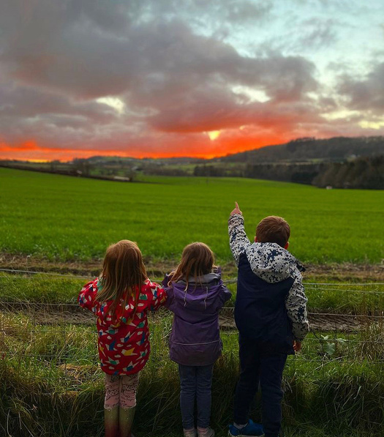
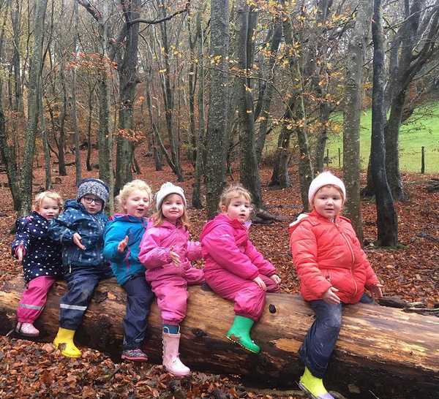
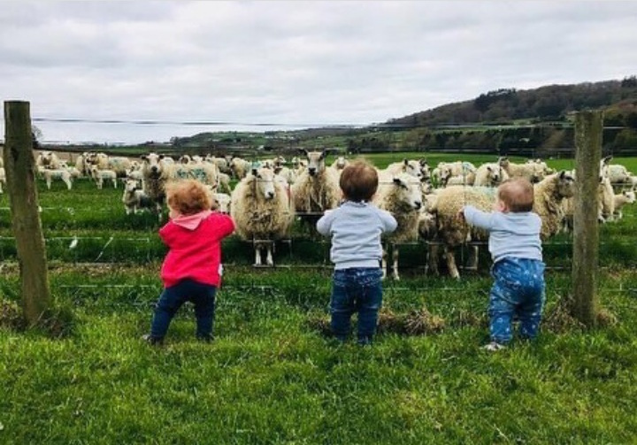
Our settings...
Plas Gogerddan Nursery
Clwb Gogerddan
Children: 397
Staff: Contract- 35 Bank Staff- 23

Slide 3
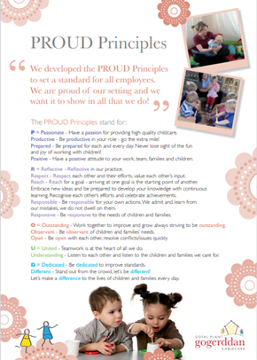
The PROUD Principles
Passionate, productive, prepared and positive
Reflective, respect, reach, responsible, responsive
Outstanding, observant and open
United and understanding
Dedicated, different and difference
Never loose sight of the fun and joy of working with children...

Slide 4
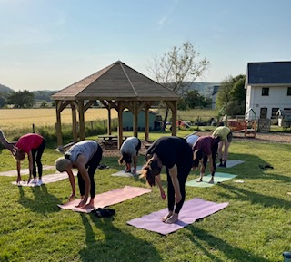
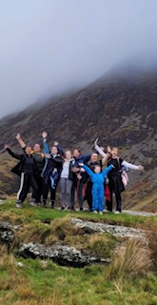
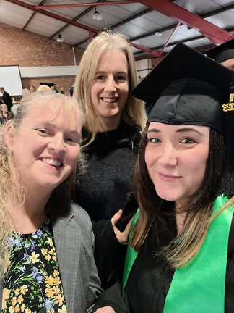
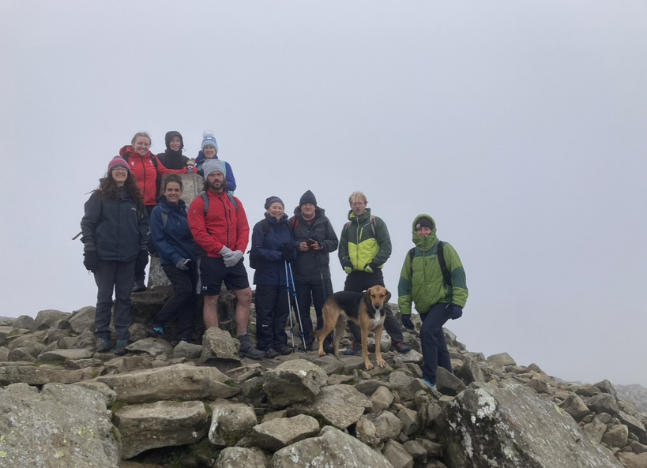
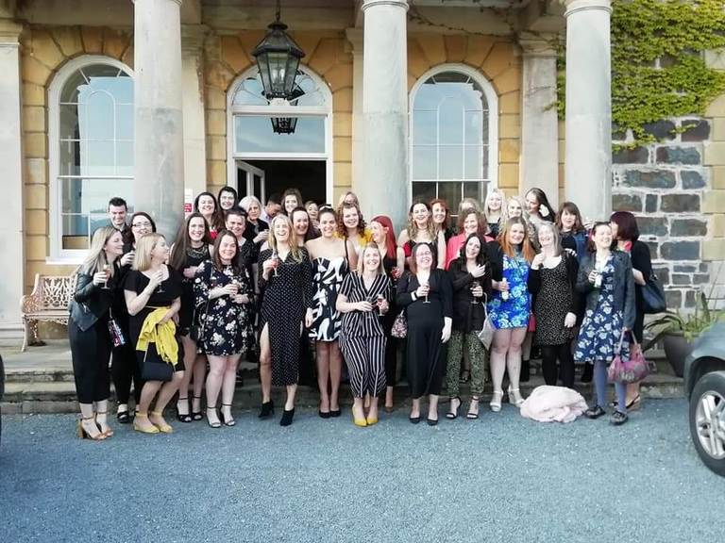
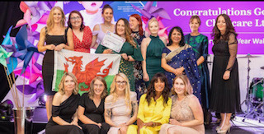
Our most valuable resource...
Celebrate
Share achievements
Staff wellbeing events
Staff awards
...OUR STAFF TEAM

Slide 5
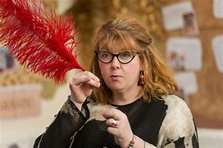
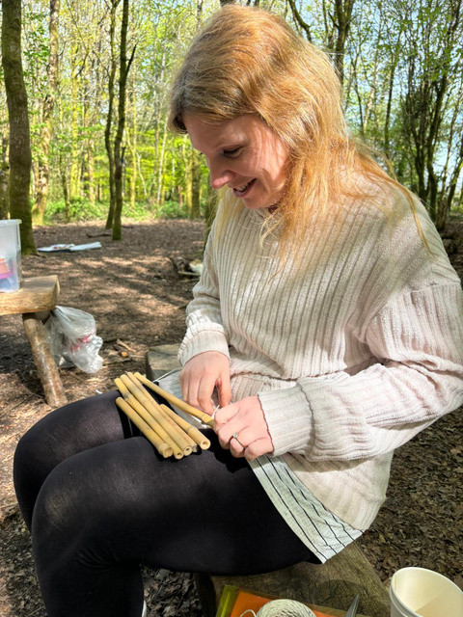
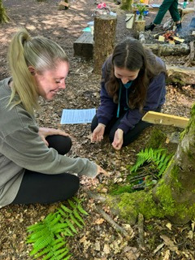

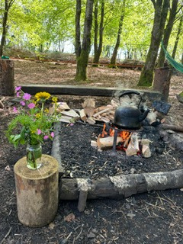
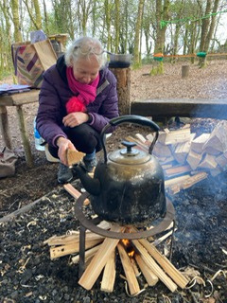
Inspire the team...
Local training providers
NDNA
Mudiad Meithrin
Ceredigion County Council
Gogerddan Childcare Training
Alistair Bryce Clegg
Ben Kingston Hughes
Kym Scott
Elizabeth Jarman
Adventures with Alice Sharp
Day of Play Community Playthings
Nursery World Conference

Slide 6

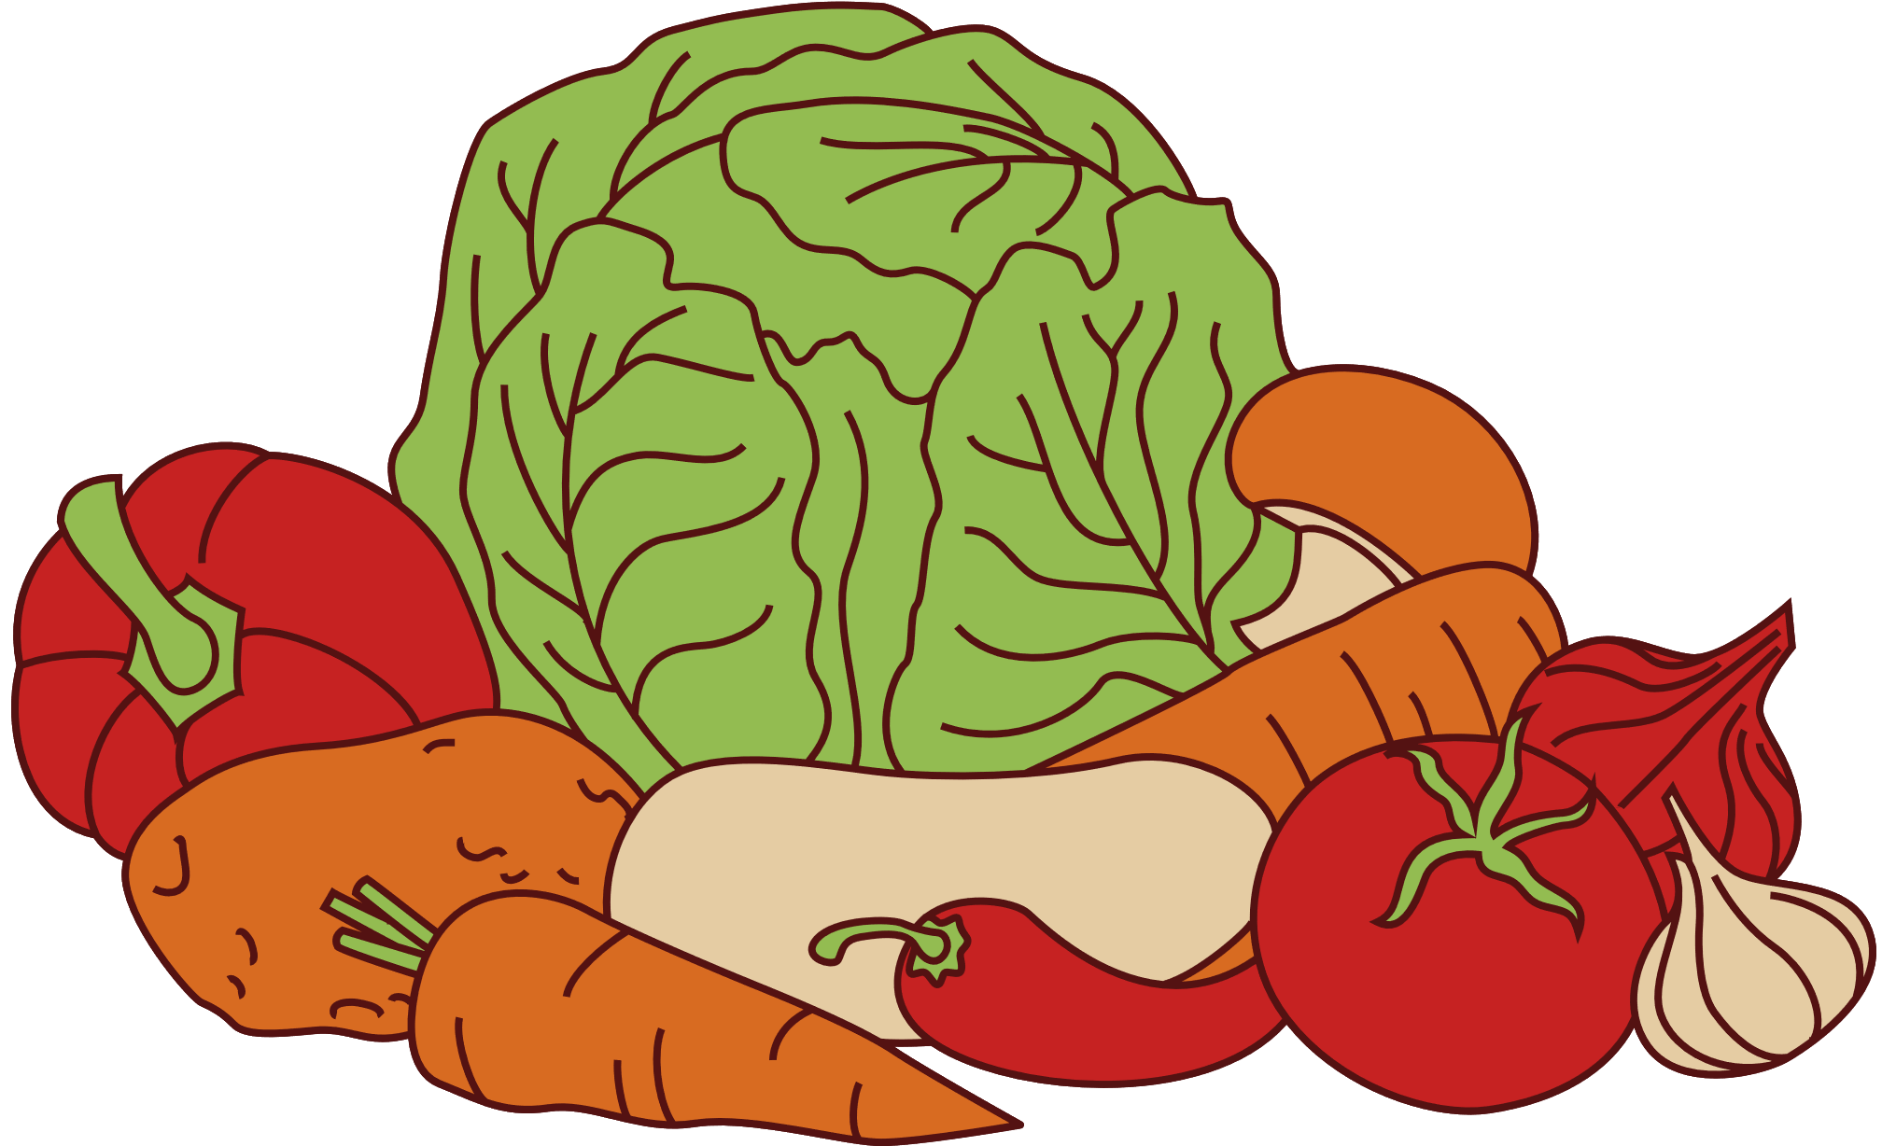

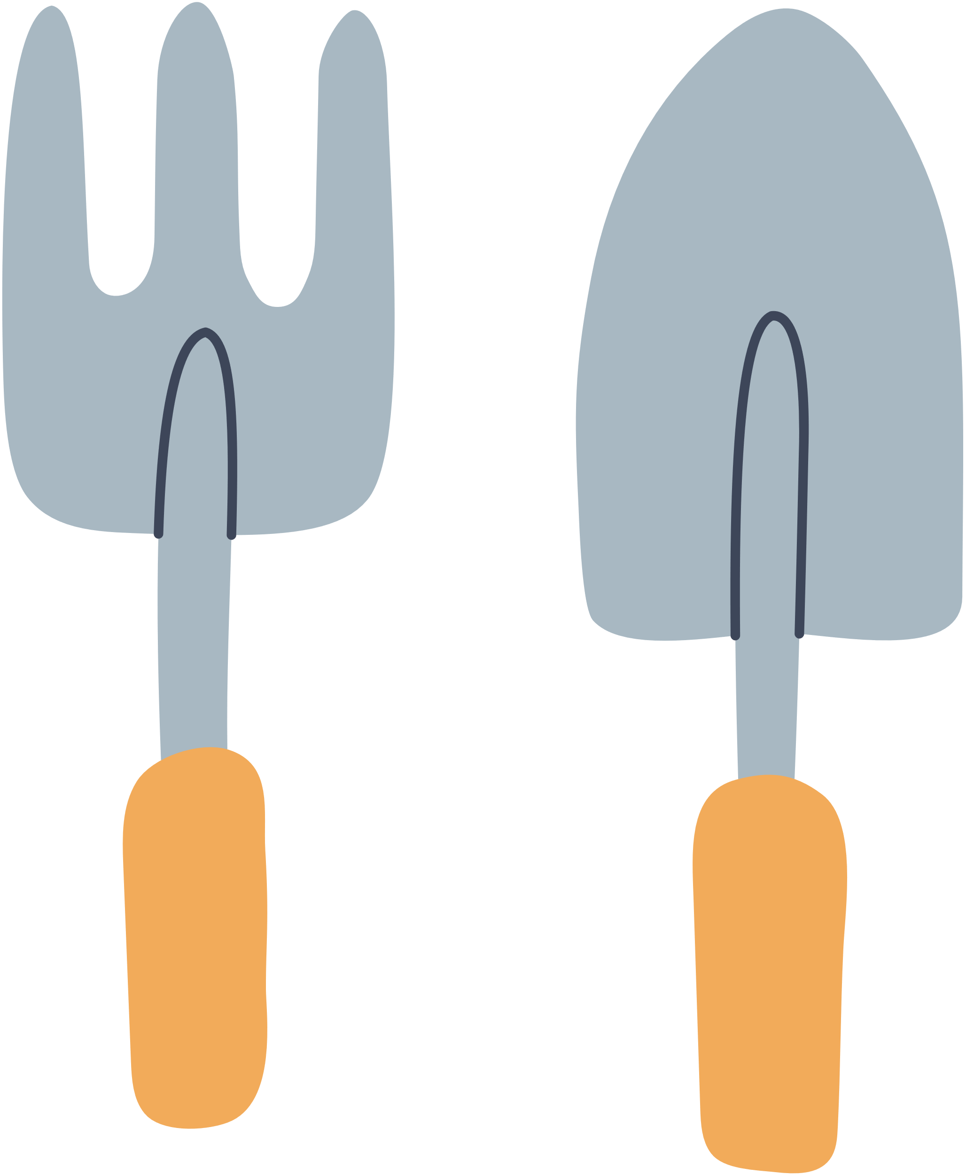
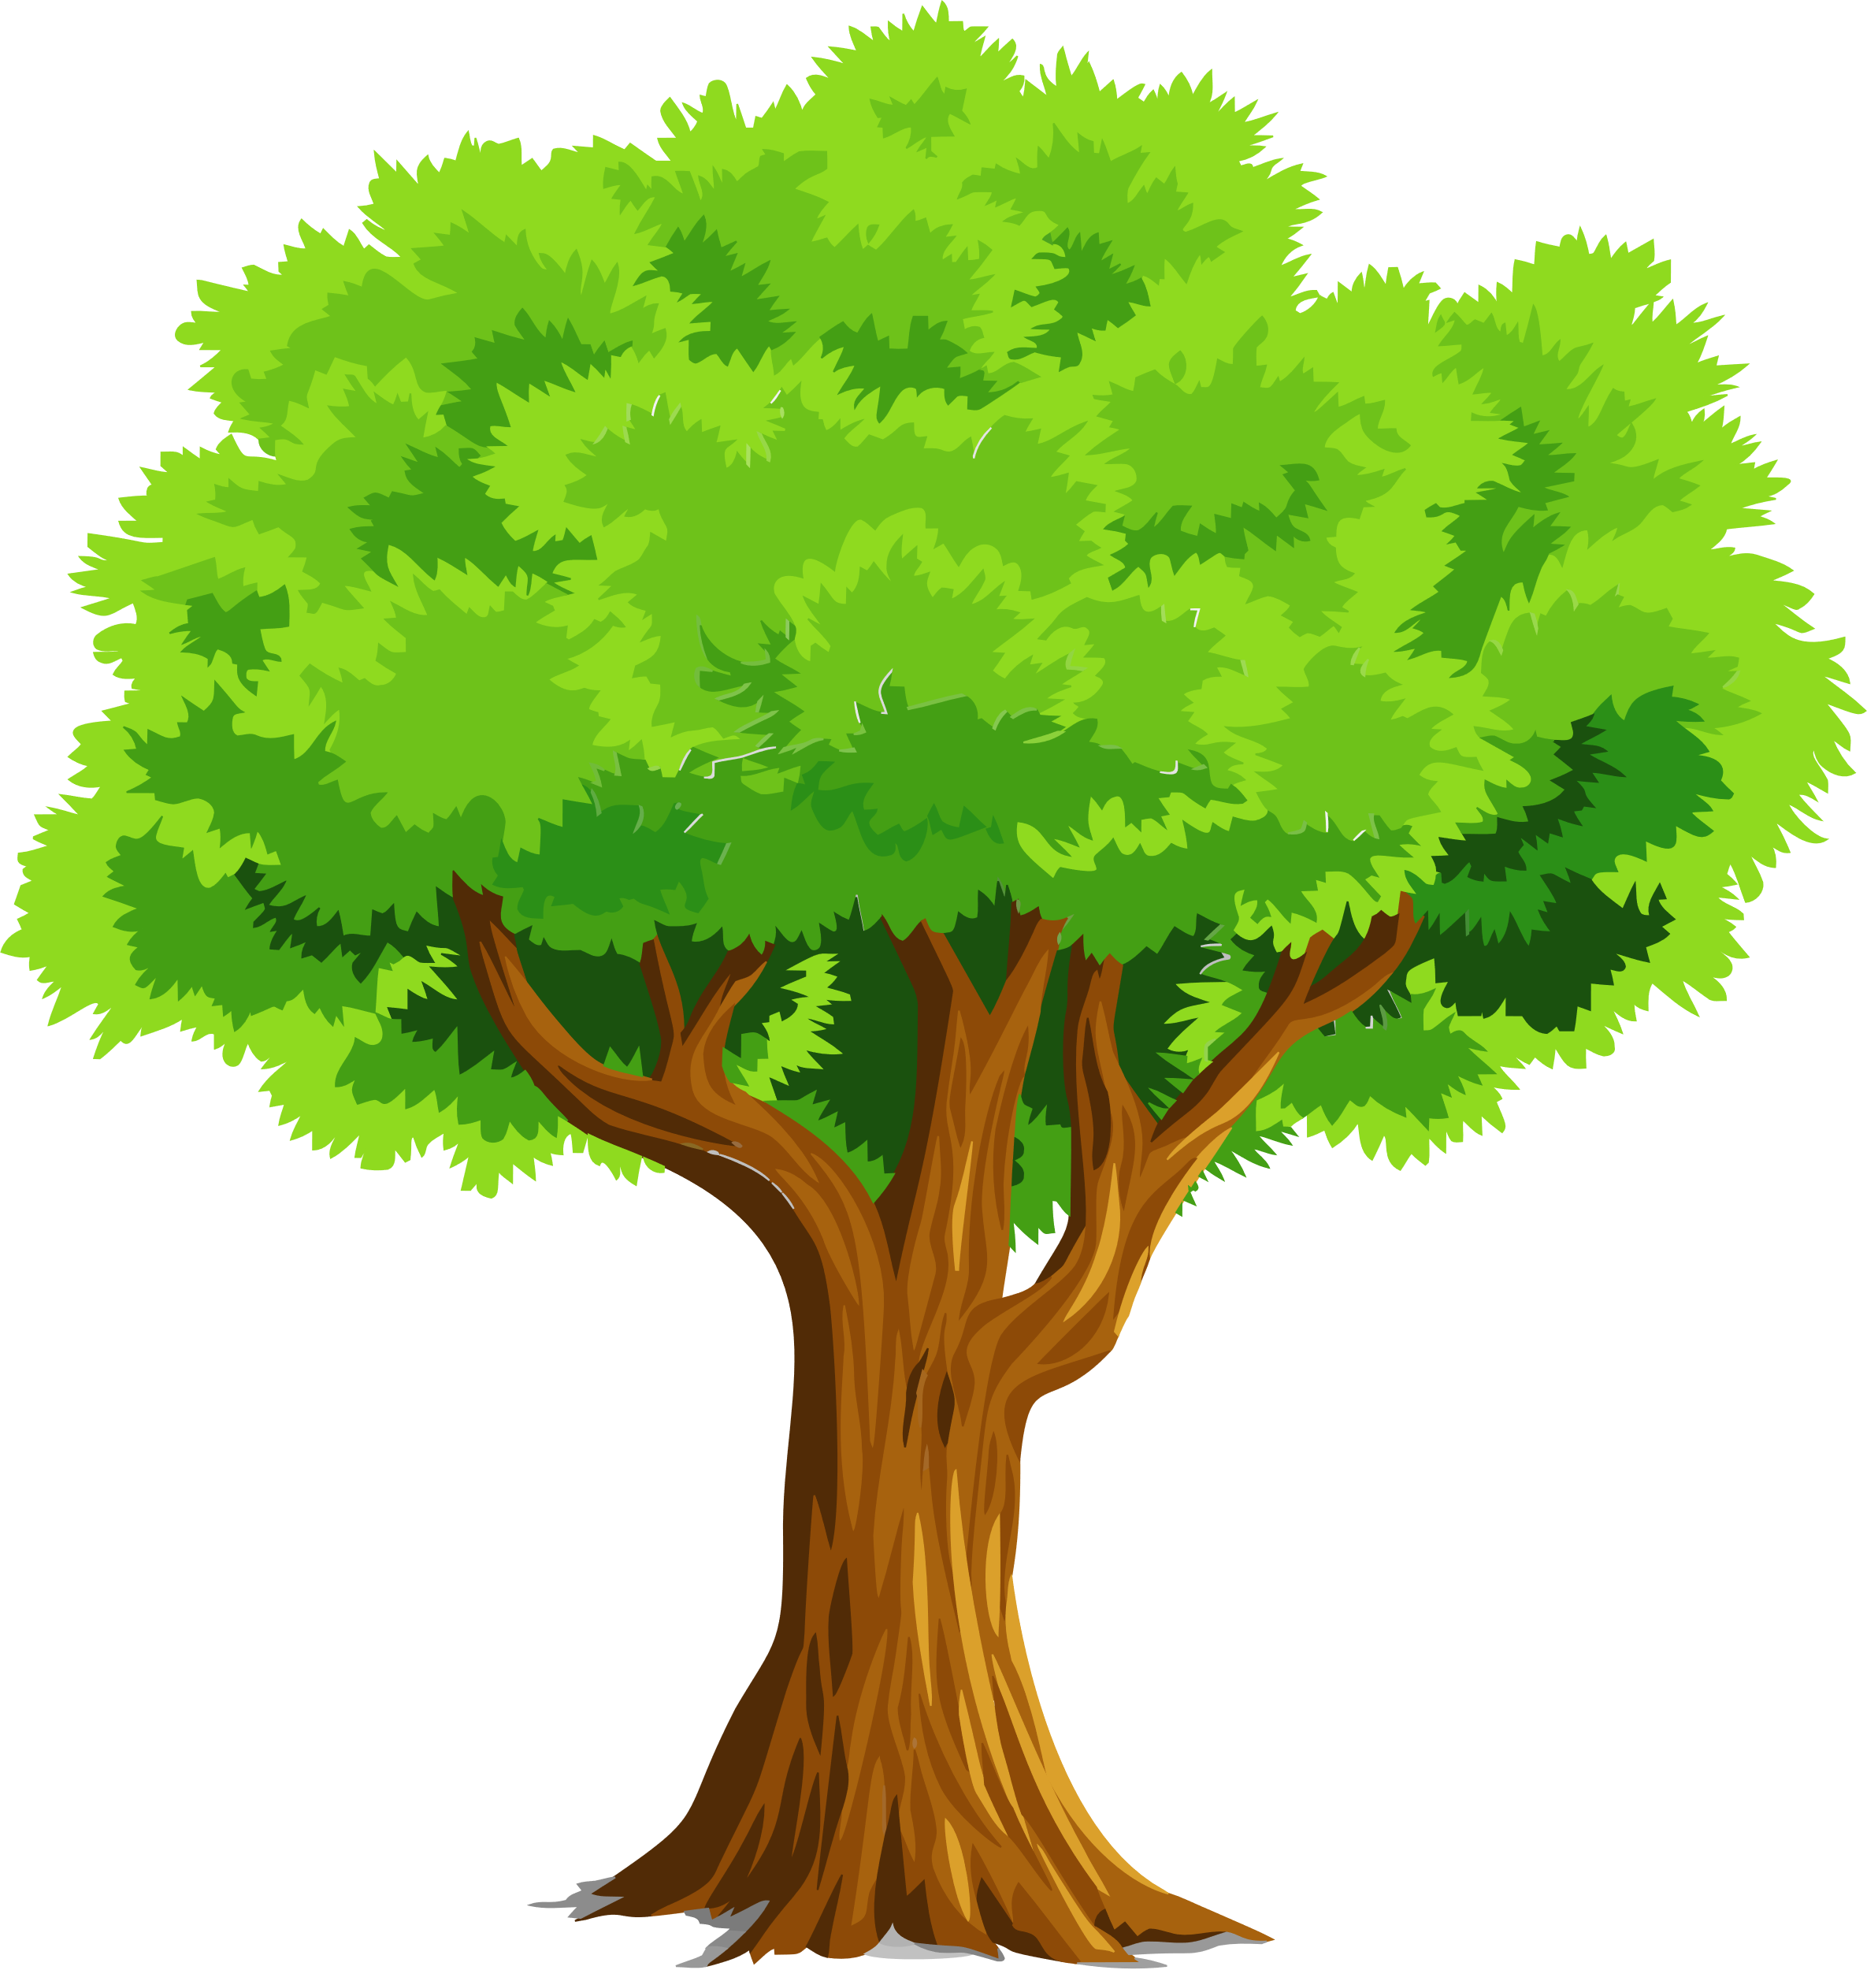
Identify staff interests and skills...
Social media
Welsh Ambassadors
ALNCO’s
Food and nutrition
Pedagogy / Play-a-gogy Lead
Clwb Garddio
Clwb Coginio
Forest School Leaders

Slide 7
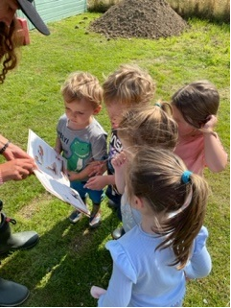
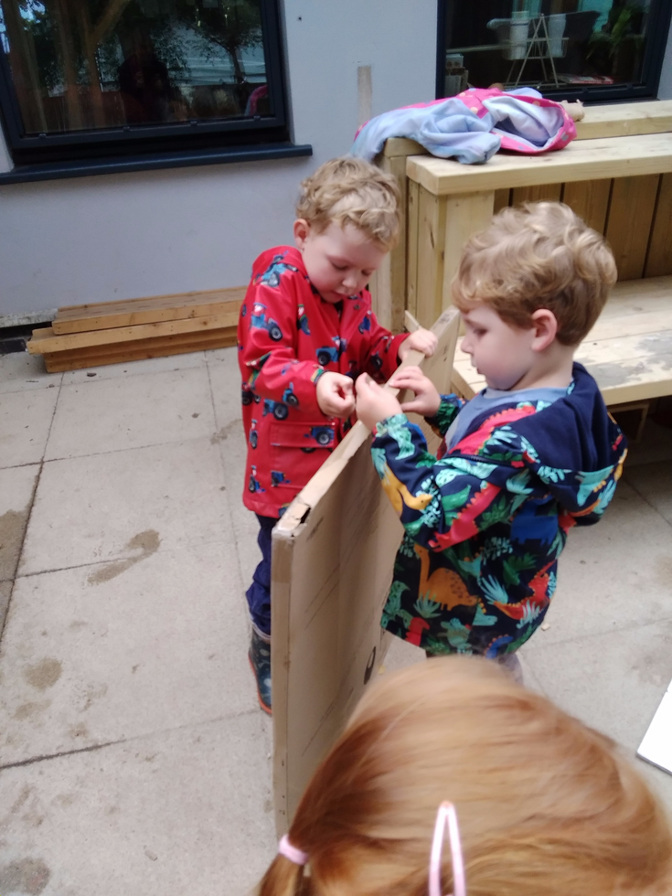
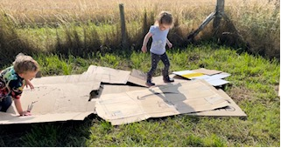
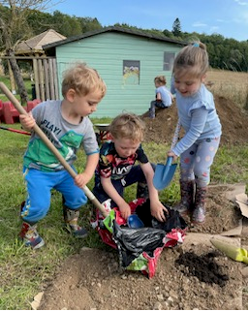
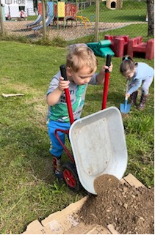
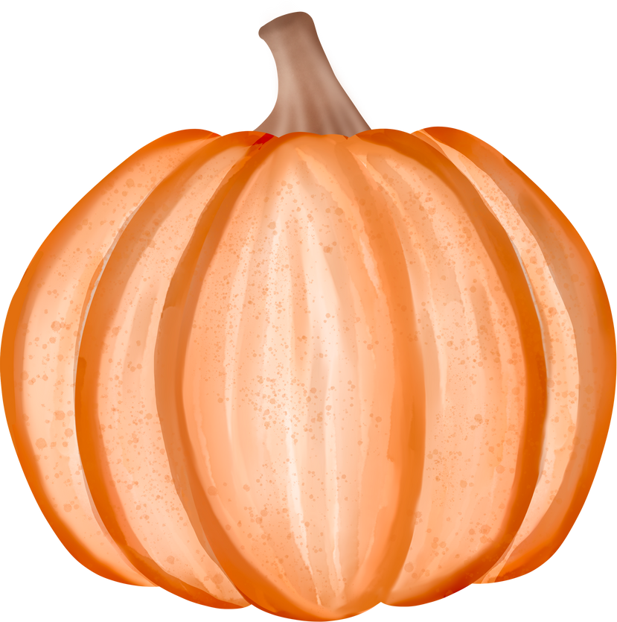
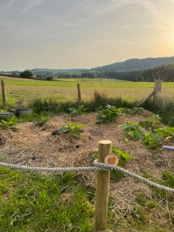
‘No Dig Garden Project’... Clwb Garddio
Endless learning ...

Slide 8
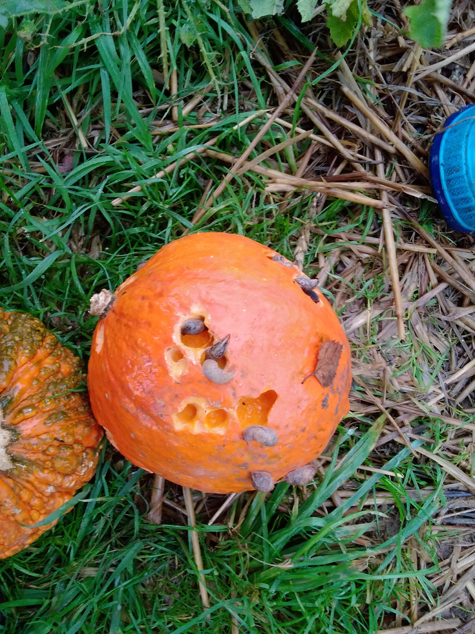
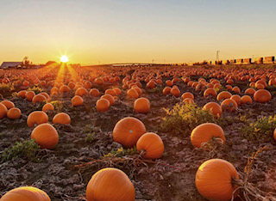
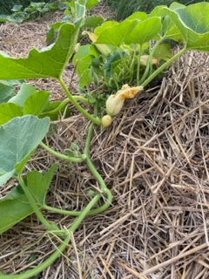
The vision...
vrs
reality...

Slide 9
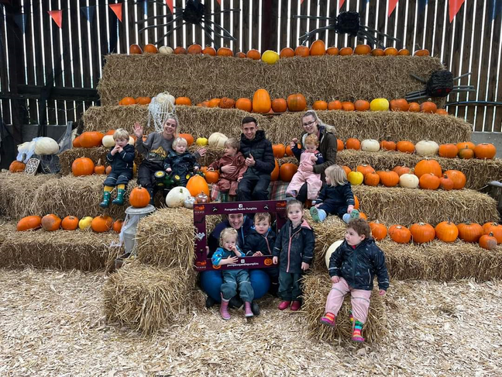

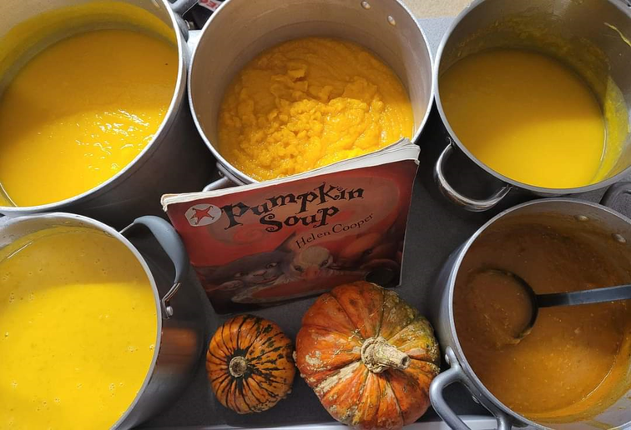

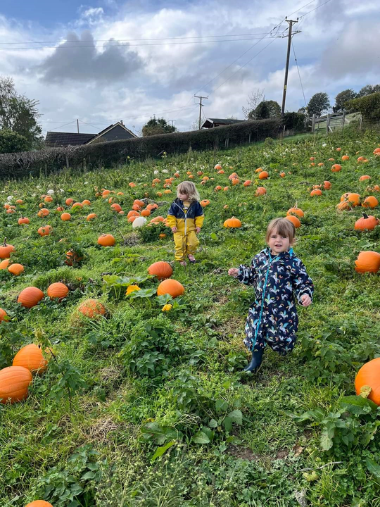
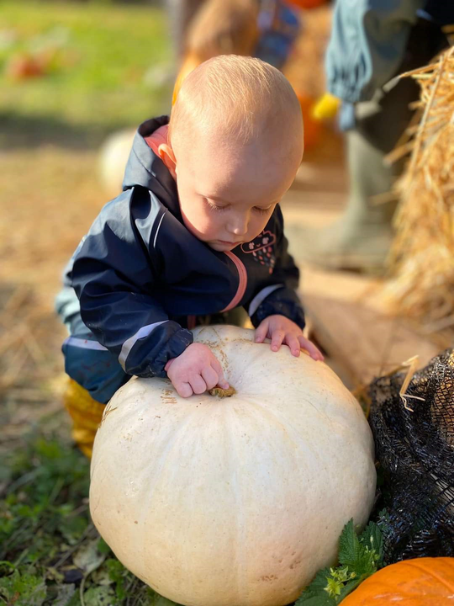
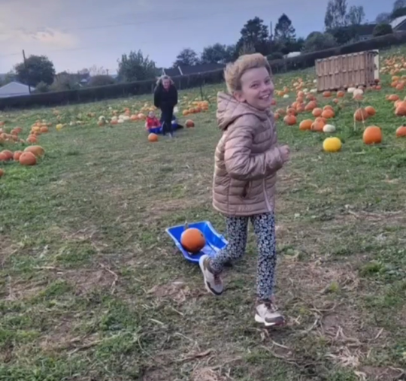
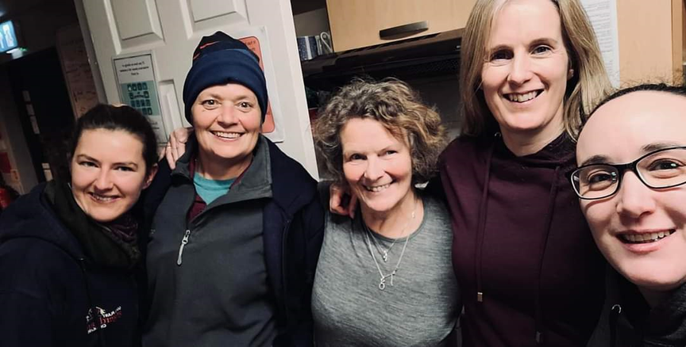
Partnerships...
Community links
Parent involvement
Trips and outings
Staff ideas

Slide 10
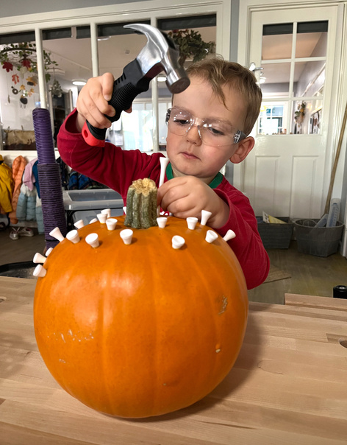
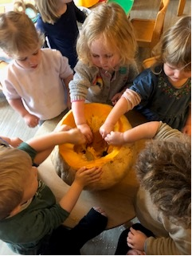
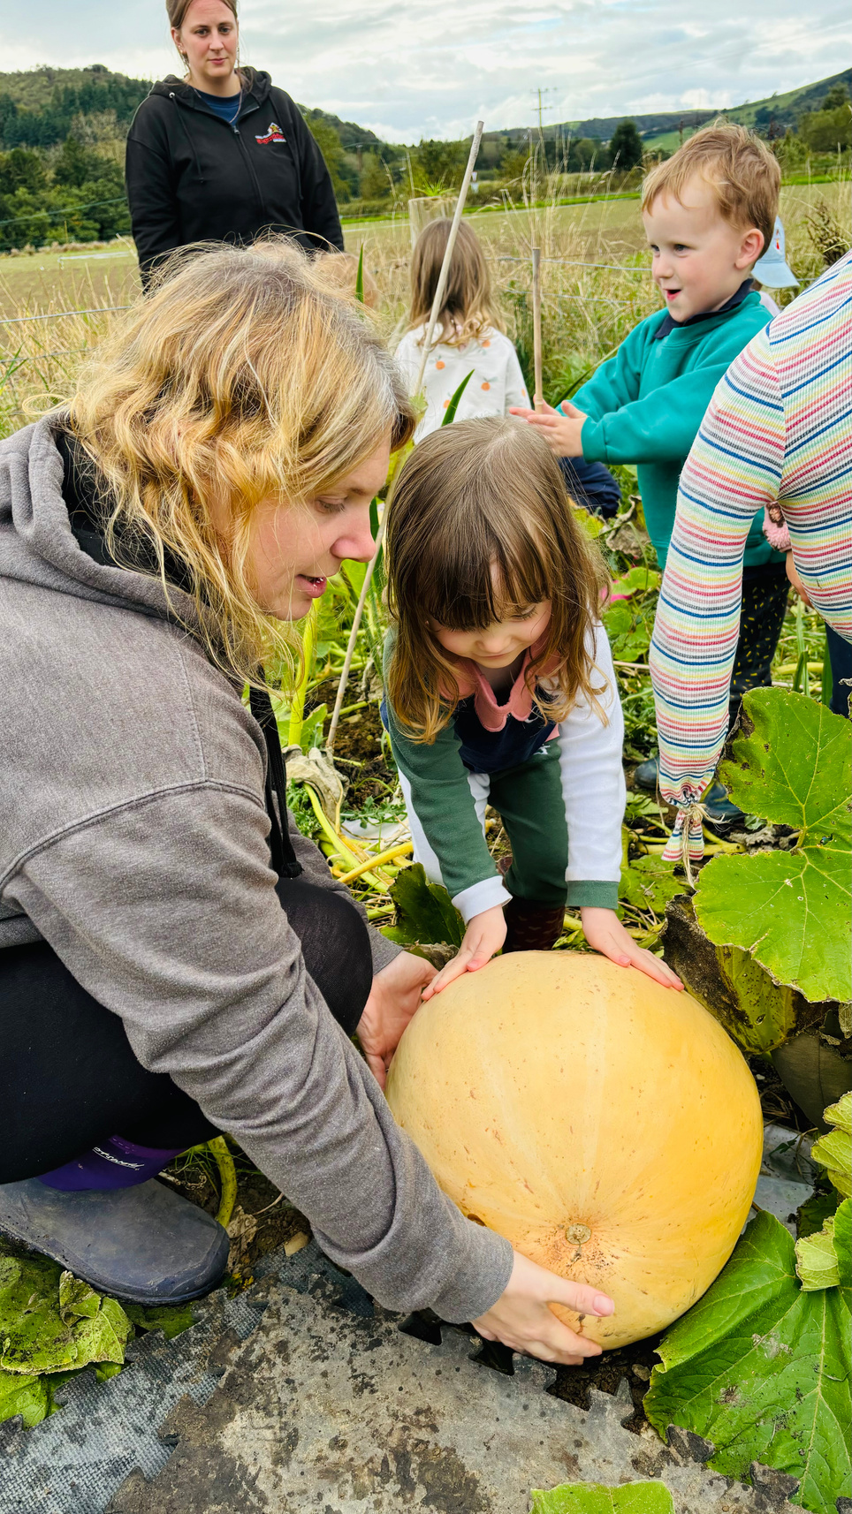
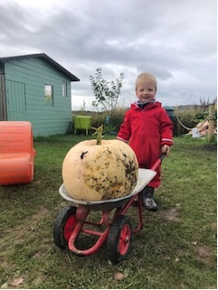
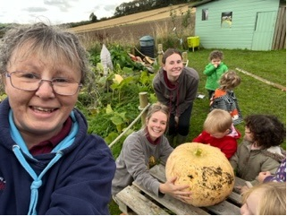
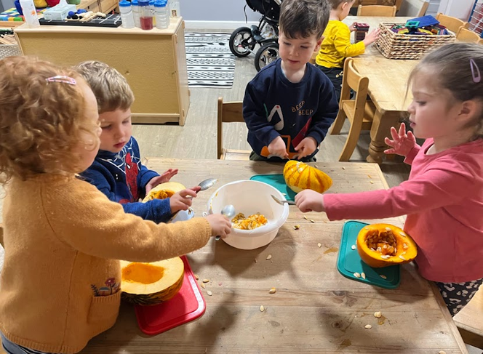
If at first you don’t succeed...
Team effort!

Slide 11
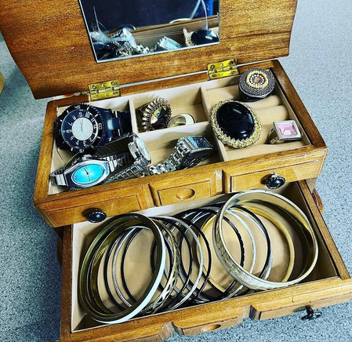
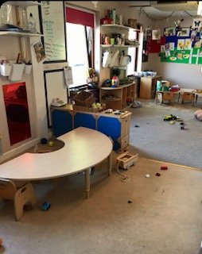
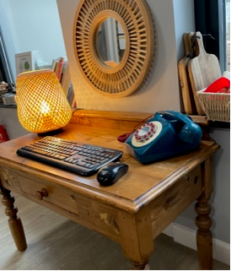
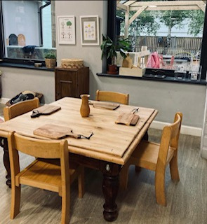
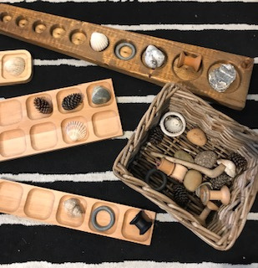
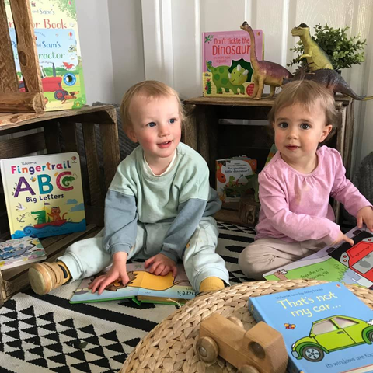
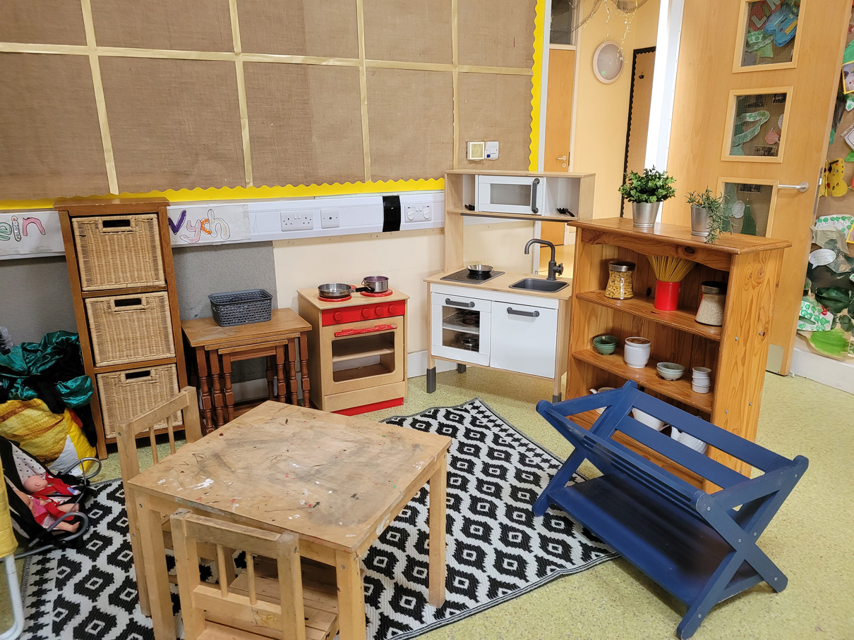
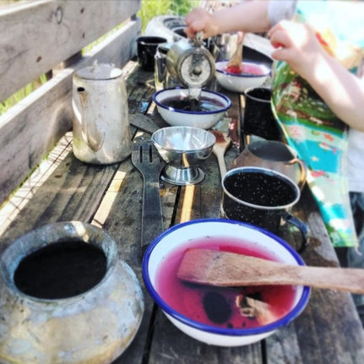
Our environments and resources...
Before...
After...

Slide 12

BIG ideas....
Environments and resources
Approach to outdoor learning
Practice
Pedagogy/ Play-a-gogy
Links within the local community
Embedding all of this throughout our settings
Our grant projects

Slide 13
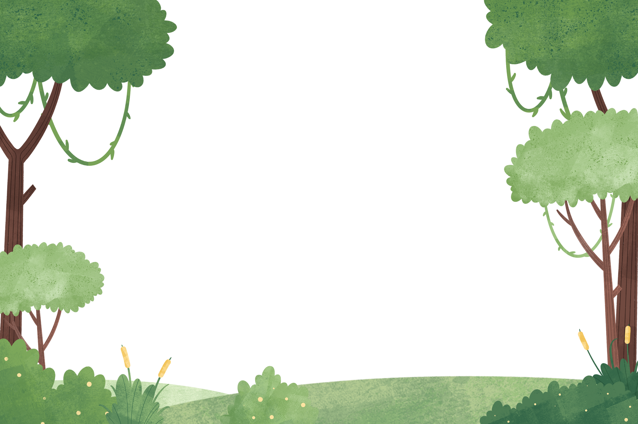
Our woodland story...

Slide 14
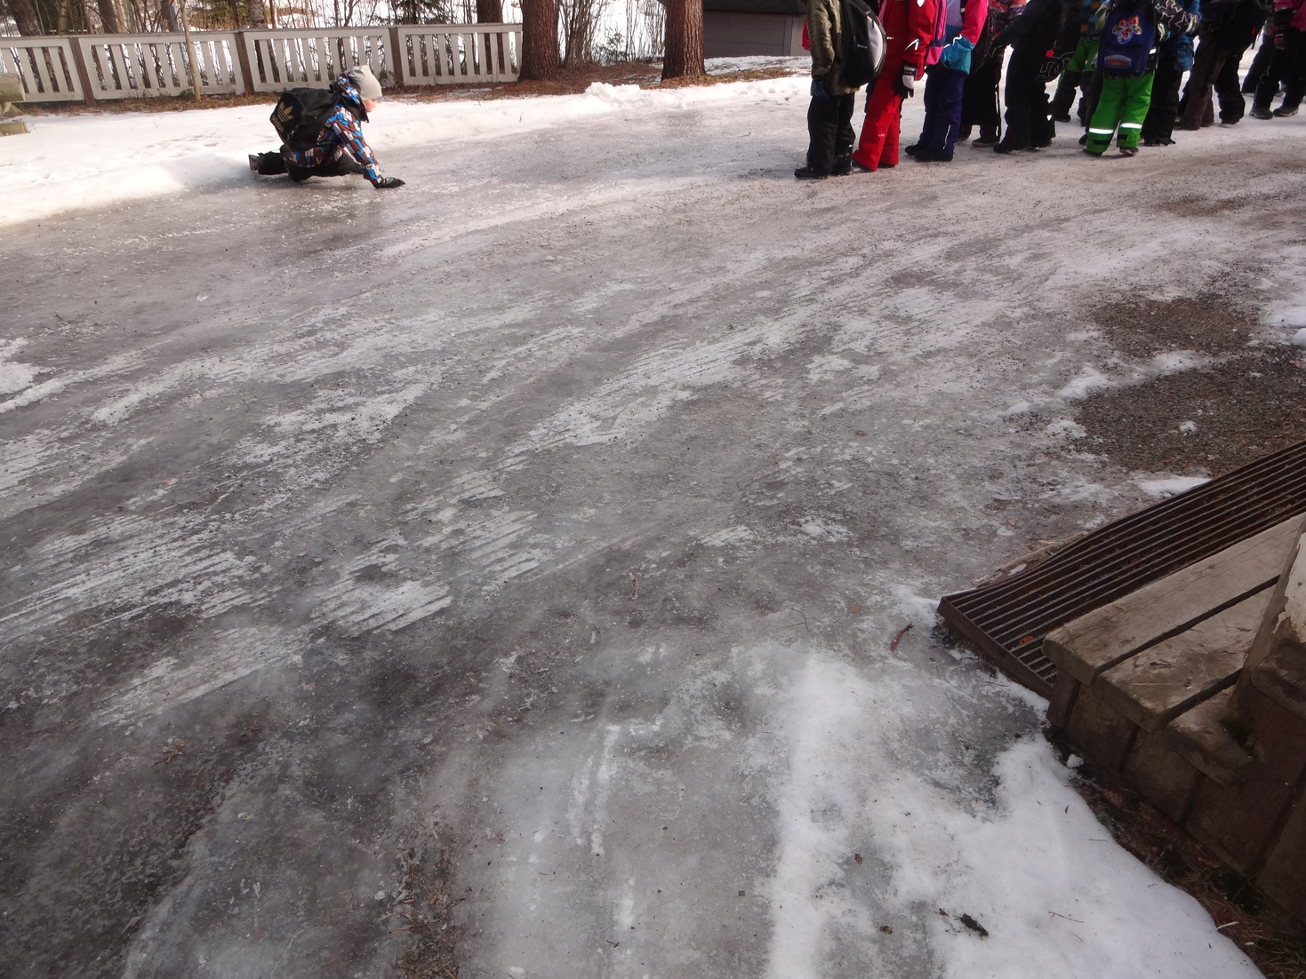





Finland

Slide 15






Our woodland Project
Before
Before
Before
After...
After...
After...

Slide 16






Our woodland Project
2020 Grwp Gwyrdd
On-going staff training:
Level 1 Forest School/ Level 3 Forest School / Outdoor First Aid

Slide 17




Using this natural site has had such a positive impact for so many children...

Slide 18




Including Clwb Gogerddan children...

Slide 19










Our grant projects
Before
After
After
Before

Slide 20






Clwb Gogerddan ‘Cwtch Ceiro Project’....
Before
During
After

Slide 21


‘Cynnal y Cardi’ Grant Project...
Before
Dark
Enclosed
No access to fresh
air / natural light
No direct access to the outdoors

Slide 22








Cynnal y Cardi Grant Project...

Slide 23




Cynnal y Cardi Grant Project...
After...
Cosy
Light
Open
Spacious

Slide 24





Cynnal y Cardi Grant Project...
Staff training...
Denmark Farm ...
Forest School
Level 3

Slide 25
Recording our progress!
Staff training
Visitors
Quality of care....
Trips and outings
Feedback
Achievements
Developments

