Slide 1
Croeso
Welcome

Slide 2
Diweddariad AGC
Sarah Glynn-Jones, Pennaeth Arolygu Gwasanaethau Oedolion a Phlant
CIW Update
Sarah Glynn-Jones, Head of Adult and Children's Services Inspection

Slide 3
Datganiadau blynyddol
Margaret Rooney, Dirprwy Brif Arolygydd
Annual returns
Margaret Rooney, Deputy Chief Inspector

Slide 4
Datganiad blynyddol llawn
Full annual return
First full annual return due in May 2022.
Submit Annual Return via CIW’s online
Must be completed by 26 May 2022 (56 days after the financial year commences).
Datganiad blynyddol llawn cyntaf ym mis Mai 2022.
Cyflwynwch y datganiad blynyddol trwy gyfrif AGC ar-lein.
Rhaid ei gwblhau erbyn 26 Mai 2022 (56 diwrnod ar ôl i'r flwyddyn ariannol ddechrau).
Guidance on completing the quality of care review-en.pdf
Quality of care review template-en.docx
Notes:
During the implementation of the 2016 Act, initial annual returns regulations were made to set out the additional information to be included in the returns and the date by which they should be submitted.
At that time, the collective understanding in Welsh Government and CIW was that the date prescribed in the regulations represented the date on which the first annual return was due. We have subsequently been advised this interpretation of the 2016 Act is incorrect. Section 10(1) of the 2016 Act requires providers to submit an annual return following the end of each financial year during which the provider is registered.
This means registered service providers will be required to submit a full annual return in May 2022 for the financial year 2021-22. In addition annual returns will be required (in May 2022) to cover each of the periods 2018-19, 2019-20 and 2020-21 (depending on year of registration).
We regret this has happened and are sorry for the inconvenience this will cause you. We will do our utmost to minimise the burden on you as providers whilst ensuring you are able to comply with the legislation.

Slide 5
Datganiadau blynyddol blaenorol
Previous annual returns
Reduce content required :
the regulated services you are registered to provide;
The names of each service you are registered for;
the name of the responsible individual for each service;
the date of registration for each service;
details of any other conditions on your registration;
the number of people to whom you provided care and support during the year;
a statement setting out how the service provider complied with the requirements of the regulations
Lleihau’r cynnwys sydd ei angen:
y gwasanaethau a reoleiddir yr ydych yn gofrestredig i’w darparu;
enwau pob gwasanaeth yr ydych yn gofrestredig ar eu cyfer;
enw’r unigolyn cyfrifol ar gyfer pob gwasanaeth;
y dyddiadau cofrestru ar gyfer pob gwasanaeth;
manylion unrhyw amodau eraill ar eich cofrestriad;
nifer y bobl y gwnaethoch roi gofal a chymorth iddynt yn ystod y flwyddyn;
datganiad sy’n amlinellu sut gwnaeth darparwr y gwasanaeth gydymffurfio â gofynion y rheoliadau

Slide 6
Datganiad cydymffurfio
Statement of compliance
Four statements will be provided from which you can select the one relevant to your position.
Rhoddir pedwar datganiad lle y gallwch ddewis yr un sy'n berthnasol i’ch sefyllfa.
Notes:
Set out your statement of compliance with regulations made under section 27(1) of the Regulation and Inspection of Social Care (Wales) Act 2016 (the 2016 Act).
Response (choose one of the following statements):
We were inspected by Care Inspectorate Wales during the reporting period. The inspection identified we were fully compliant with all regulations under section 27(1) of the 2016 Act.
We were inspected by Care Inspectorate Wales during the reporting period. The inspection identified we were not fully compliant with all regulations under section 27(1) of the 2016 Act. We subsequently took action(s) to improve compliance with the relevant regulations.
We were not inspected by Care Inspectorate Wales during the reporting period. However, we have established an internal system for monitoring, reviewing and improving the quality of care and support provided by the service. This identified we were fully compliant with all regulations under section 27(1) of the 2016 Act.
We were not inspected by Care Inspectorate Wales during the reporting period. However, we have established an internal system for monitoring, reviewing and improving the quality of care and support provided by the service. This identified we were not fully compliant with all regulations under section 27(1) of the 2016 Act. We subsequently took action(s) to improve compliance with the relevant regulations.
Statement to be included within all AARs
Please refer to the 2021/22 Annual Return for the most recent statement of compliance with regulations under section 27(1) of the Regulation and Inspection of Social Care (Wales) Act 2016.

Slide 7
Modiwl hyfforddi diogelu newydd ar gyfer y sector cyhoeddus a'r trydydd sector yng Nghymru
New safeguarding training module for public and third sectors Wales
Esyllt Crozier
Gofal Cymdeithasol Cymru
Social Care Wales

Slide 8
Trosolwg
Overview
Mae modiwl hyfforddi diogelu cyson wedi'i lansio ar gyfer staff y sector cyhoeddus a'r sector gwirfoddol ledled Cymru.
Datblygwyd y modiwl hyfforddi gan Gofal Cymdeithasol Cymru yn unol â Gweithdrefnau Diogelu Cymru, a lansiwyd yn 2019.
Mae’r gweithdrefnau’n manylu ar rolau a chyfrifoldebau hanfodol ymarferwyr i sicrhau eu bod yn diogelu plant ac oedolion sydd mewn perygl o gael eu cam-drin a'u hesgeuluso.
A single consistent safeguarding training module has been launched for public and voluntary sector staff across Wales.
The training module has been developed by Social Care Wales in line with the Wales Safeguarding Procedures, which launched in 2019.
The procedures detail the essential roles and responsibilities for practitioners to ensure that they safeguard children and adults who are at risk of abuse and neglect.
Notes:
The procedures were designed to standardise practice across all of Wales and the training module has been developed with the same intention. The module is for Group A training (equivalent to Level 1 Health).

Slide 9
Modiwl hyfforddi
Training module
Bydd cwblhau’r modiwl hyfforddi newydd yn galluogi pawb i:
esbonio'r term 'diogelu'
adnabod camdriniaeth neu'r risg o gamdriniaeth, niwed neu esgeulustod
gwybod pa gamau i'w cymryd os ydynt yn amau - neu’n dyst i - gamdriniaeth, niwed neu esgeulustod, neu os bydd rhywun yn dweud wrthynt ei fod yn cael ei gam-drin
dangos dealltwriaeth sylfaenol o'r cyfreithiau sy'n ymwneud â diogelu
cydnabod bod dyletswydd arnynt i roi gwybod am gamdriniaeth, niwed neu esgeulustod.
Completing the new training module will enable everyone to:
explain the term 'safeguarding'
recognise abuse or the risk of abuse, harm or neglect
know what actions to take if they witness or suspect abuse, harm or neglect, or if someone tells them they are being abused
demonstrate a basic understanding of the laws concerning safeguarding
recognise that they have a duty to report abuse, harm or neglect.
Notes:
This module contains 13 sections and includes scenario questions to help users build a practical understanding of safeguarding and what action to take if they think someone may be at risk.

Slide 10
Hyfforddiant orfodol
Mandatory training
Mae hyfforddiant diogelu yn orfodol i'r holl staff sy'n gweithio yn y sector cyhoeddus yng Nghymru ac i lawer o staff sy'n gweithio yn y sector gwirfoddol a'r trydydd sector.
Er mwyn sicrhau bod yr e-fodiwl yn berthnasol i'r holl staff, fe'i datblygwyd mewn cydweithrediad agos â sefydliadau statudol a gwirfoddol.
Safeguarding training is mandatory for all staff working in the public sector in Wales and many working in the voluntary sector.
To ensure the e-module is relevant to all staff, it has been developed in close collaboration with statutory and voluntary organisations.

Slide 11
Hygyrchedd
Accessibility
Mae'r modiwl yn gwbl hygyrch.
Mae'n gydnaws â darllenwyr sgrin ar gyfer y rheiny sydd â nam ar eu golwg
mae’n defnyddio Text Help Read & Write i helpu defnyddwyr â dyslecsia i ganolbwyntio ar ddarnau allweddol o wybodaeth
a gall defnyddwyr sydd â phroblemau symudedd ei lywio drwy ddefnyddio’r allweddi tab.
The module is fully accessible.
It is compatible with screen readers for those with visual impairments
uses Text Help Read and Write to help dyslexic users focus on key pieces of information
and can be navigated using the tab keys by users with mobility issues.

Slide 12
Geirdaon
Testimonials
"Mae'r Bwrdd Diogelu Annibynnol Cenedlaethol yn hapus iawn i gymeradwyo modiwl hyfforddi Gweithdrefnau Diogelu Cymru’n gynnyrch o ansawdd uchel. Mae'r hyfforddiant yn taro'r nodyn cywir ac roeddem yn hoff iawn o'r senarios. Mae cydbwysedd priodol rhwng y gwahanol grwpiau yn y boblogaeth - oedolion a phlant, ymhlith dimensiynau amrywiol eraill. Da iawn.” - Bwrdd Diogelu Annibynnol Cenedlaethol
"Fe wnes i fwynhau'r cwrs yn fawr ac roedd yn ddiddorol ac mor rhyngweithiol â phosib gyda phwnc o'r fath." - Swyddog hyfforddi a datblygu awdurdod lleol
"Mae hwn yn adnodd gwych." - Arweinydd diogelu'r gwasanaeth tân
“The National Independent Safeguarding Board are very happy to endorse the Wales Safeguarding Procedures training module as a high-quality product. The training strikes the right tone and we very much liked the scenarios. There is an appropriate balance between different groups in the population - adults and children, among other diverse dimensions. Well done.” - National Independent Safeguarding Board
“I really enjoyed the course and found it interesting and as interactive as possible with such a subject.” - A local authority training and development officer
“This is a great resource.” - Fire service safeguarding lead

Slide 13
Geirdaon
Testimonials
"Yn gyffredinol, roeddwn i wir yn hoffi llif a chyflymder y cynnwys ar gyfer y lefel hon, ac roeddwn i wir yn hoffi'r senarios a'r hyn maen nhw'n ei ychwanegu o ran galluogi pobl i feddwl am y broses. Mae'r negeseuon allweddol yn syml ac yn cael eu cyflwyno’n dda. Mae’r gwaith graffeg yn dda ac ati. Felly, ar y cyfan, rwy’n hoffi’r modiwl ar gyfer y gynulleidfa darged benodol hon." - Arweinydd bwrdd diogelu rhanbarthol
"Rwy'n hoffi'r fformat a'r iaith, mae'n glir ac yn hawdd ei ddilyn. Da iawn ar y cyfan gyda senarios bywyd go iawn da" - Arweinydd bwrdd diogelu rhanbarthol
“Generally, I really liked the flow and pace of the content for this level, and I really liked the scenarios and what they add in terms of allowing people to think the process through. The key messages are kept simple and come across well. Graphics are good etc. So, on the whole, really like the module for this particular target audience.” - A regional safeguarding board lead
“I like the format and language, it’s clear and easy to follow. Generally very good with good real life scenarios” - A regional safeguarding board lead

Slide 14
Linc
Link
Modiwl Diogelu Grwp A
Group A Safeguarding Training Module

Slide 16
Defnyddio tystiolaeth
Digwyddiad Darparwr RISCA
Tachwedd 2021
Using evidence
RISCA Provider Event
November 2021

Slide 17
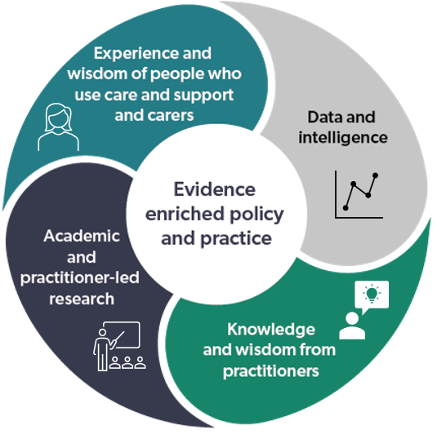
What do we mean by evidence?
Beth ydyn ni’n ei olygu wrth dystiolaeth?
Trwy ymarfer sy'n seiliedig ar dystiolaeth, rydym yn golygu bod penderfyniadau ynghylch sut i ddarparu gofal a chefnogaeth yn cael eu llywio gan ddealltwriaeth o:
y dystiolaeth orau sydd ar gael am yr hyn sy'n effeithiol - gan dynnu o ymchwil a data
doethineb a phrofiad ymarferwyr
doethineb, profiad a barn pobl sy'n defnyddio gofal a chefnogaeth a'u gofalwyr
By evidence enriched practice, we mean that decisions about how to provide care and support are informed by an understanding of:
the best available evidence about what is effective – drawing from research and data
the wisdom and experience of practitioners
the wisdom, experience and views of people who use care and support and their carers
Gofal Cymdeithasol Cymru: wedi'i addasu o Ymchwil ar Waith
Social Care Wales: adapted from Research in Practice

Slide 18
Ein nod
Our goal
Cysylltu ac adeiladu perthnasoedd i helpu pobl i wneud synnwyr o dystiolaeth a'i chymhwyso i'w byd eu hunain….
Gwella cynllunio, ymarfer, llunio polisïau ac yn y pen draw ganlyniadau i bawb
Connecting and relationship building to help people make sense of evidence and apply it to their own world….
To improve planning, practice, policy-making and ultimately outcomes for all

Slide 19
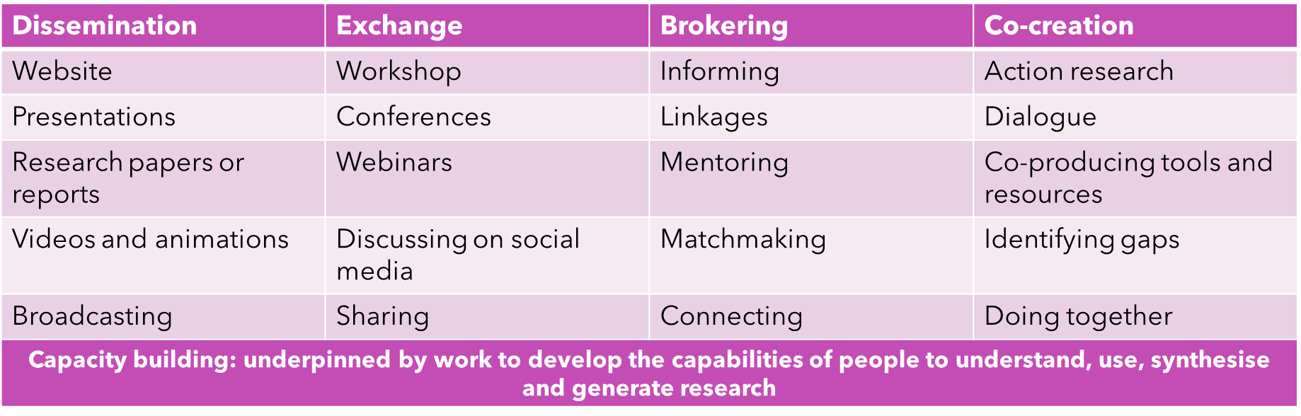
Sut y byddwn yn helpu pobl i defnyddio tystiolaeth?
How will we help people to use evidence?

Slide 20
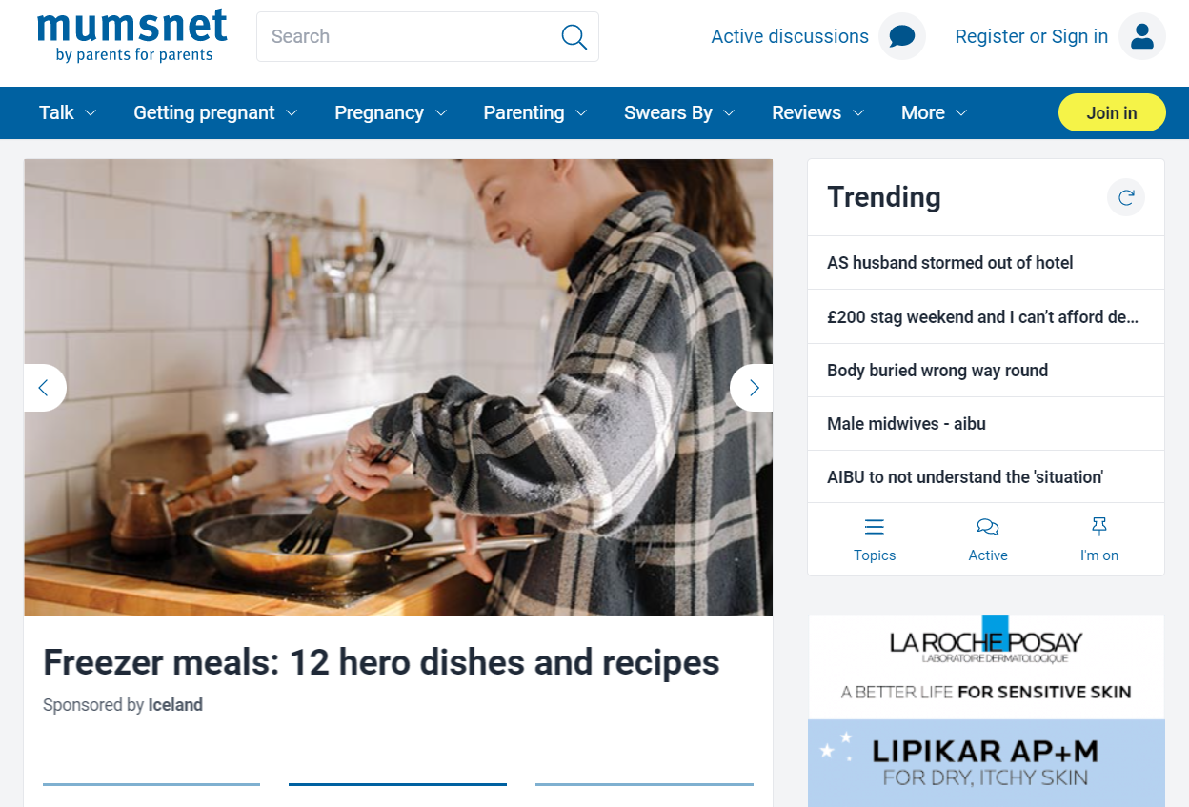
Example / Enghraifft: Mumsnet

Slide 21

Deall yr hyn sydd ei angen ar ddarparwyr
Understanding what providers need
Cyfranogwyr
Unigolion cyfrifol
Rheolwyr cofrestredig
Cydlynwyr gweithgareddau
Gweithwyr rheng flaen
Strategaeth samplu
Cynrychiolydd y dirwedd gofal cymdeithasol yng Nghymru
Cynydd
15 cyfweliad hyd yn hyn
Participants
Responsible individuals
Registered managers
Activities coordinators
Front line workers
Sampling Strategy
Representative of the social care landscape in Wales
Progress
15 interviews so far

Slide 22
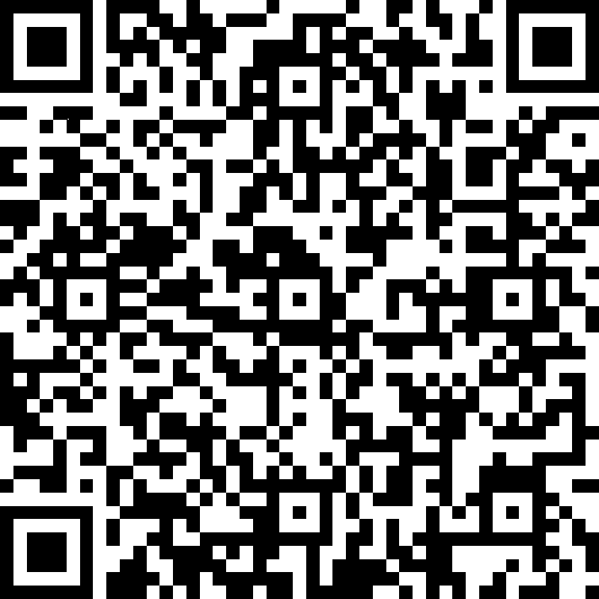
Cysylltwch a ni
Get in touch
E-bostiwch ni ar:
Research@socialcare.wales
Llenwch ffurflen yn:
https://tinyurl.com/3w3frc84
neu defnyddiwch y cod QR:
Email us at:
Research@socialcare.wales
Fill in a form at:
https://tinyurl.com/3w3frc84
or use the QR code:

Slide 24
Diweddariad Gorfodaeth
Sharon Eastlake, Uwch Reolwr Cofrestru a Gorfodi
Enforcement Update
Sharon Eastlake, Senior Manager Registration and Enforcement

Slide 25
bydd adroddiadau arolygu cyhoeddedig yn cynnwys manylion meysydd a nodwyd i'w gwella a manylion lefel uchel y meysydd ar gyfer gweithredu â blaenoriaeth.
bydd darparwyr yn derbyn Adroddiad Gweithredu Blaenoriaeth yn cynnwys hysbysiadau gweithredu blaenoriaeth.
byddwn yn rhannu hysbysiadau gweithredu blaenoriaeth gyda'r comisiynwyr - ni fyddant bellach ynghlwm wrth adroddiadau arolygu
bydd adroddiadau arolygu cyhoeddedig yn cynnwys manylion meysydd a nodwyd i'w gwella a manylion lefel uchel y meysydd ar gyfer gweithredu â blaenoriaeth.
bydd darparwyr yn derbyn Adroddiad Gweithredu Blaenoriaeth yn cynnwys hysbysiadau gweithredu blaenoriaeth.
byddwn yn rhannu hysbysiadau gweithredu blaenoriaeth gyda'r comisiynwyr - ni fyddant bellach ynghlwm wrth adroddiadau arolygu
Diweddariad: Adrodd ar ddiffyg cydymffurfio
Update: Reporting on non-compliance
bydd adroddiadau arolygu cyhoeddedig yn cynnwys manylion meysydd a nodwyd i'w gwella a manylion lefel uchel y meysydd ar gyfer gweithredu â blaenoriaeth.
bydd darparwyr yn derbyn Adroddiad Gweithredu Blaenoriaeth yn cynnwys hysbysiadau gweithredu blaenoriaeth.
byddwn yn rhannu hysbysiadau gweithredu blaenoriaeth gyda'r comisiynwyr - ni fyddant bellach ynghlwm wrth adroddiadau arolygu
published inspection reports will contain details of identified areas for improvement and high level detail of areas for priority action.
providers will receive a Priority Action Report containing priority action notices.
we will share with commissioners Priority Action Notices – they will no longer be attached to inspection reports.

Slide 26
Notes:
We took on board feedback received and have revised the non-compliance summary table. We will review this again in the future.
The table will firstly set out the status of the non compliance and their definitions. We have set out four statuses. New- , Reviewed – Not achieved - , achieved. We then have an explanatory text for the public regarding when CIW would issue a priority action notice.
Should there be a need to issue a priority action notice in respect of a regulatory failing, it will be shown in the PAN table. Firstly the regulation number, followed by a summary of the non-compliance and what action the service provider must take, then the status, whether this is a new nc, one which was reviewed but not tested, not achieved or achieved.
An example ; reg 80, summary: There are insufficient arrangements for reviewing the quality of care and support. The responsible individual must have suitable arrangements in place to assess, monitor and improve the quality and safety of the service.
An explanatory text for areas for improvement explains where areas for improvement are not achieved we may escalate an issue a PAN. Where areas for improvements have been identified they will also be shown in a table using the same logic, and status. For example:
Reg 36, supervision and training records are not comprehensive. The provider must maintain a written record of all training and supervision undertaken or to be undertaken by staff. Status: achieved.

Slide 27
Diweddariad i’r polisi sichrau gwelliant a gorfodaeth
Update to the securing improvement and enforcement policy
Pennod 5
Chapter 5
Yn gynnwys fwy o fanylder ynglyn a’r llwybr gorfodi troseddol.
Contains more detail in respect of criminal enforcement pathway.
Notes:
Our ‘Securing Improvement and Enforcement policy’ explains how we use our civil enforcement powers if services are not providing good quality care or are not meeting the requirements of the law.
Chapter 5 contains detail on how we use our criminal enforcement powers to hold relevant people to account for serious failures in regulated services. CIW may take criminal enforcement action in response to breaches of certain regulations, and sections of the Regulation and Inspection of Social Care (Wales) Act 2016 (‘the Act’). We have recently published our Criminal enforcement policy which explains further our approach to criminal enforcement.

Slide 28
Polisi gorfodaeth troseddol Criminal enforcement policy
Manylir ar bob cam o’r llwybr yn y polisi.
Mae manylion troseddau rheoliadol ar ein gwefan.
Each stage of the pathway is detailed within the policy.
Details of regulatory offences are on our website.
Llwybr:
adolygiad cychwynnol
ymchwiliad troseddol
erlyniad
Pathway:
initial review
criminal investigation
prosecution
Notes:
Initial review
An initial review may be an appropriate course of action where we become aware of incidents or events that may constitute an offence under the legislation. The initial review allows us to establish the facts and consider if we have evidence to believe an offence has been committed. The decision to undertake an Initial Review is made at Improvement and Enforcement Panel.
Criminal investigation
The decision to undertake a criminal investigation will only be made by the Improvement and Enforcement Board. The board will consider:
Whether there is reason to believe an offence contained within RISCA has been committed; or
a failure in care/regulatory breach has occurred and such failure results in: a) avoidable harm (whether of a physical or psychological nature) to an individual b) an individual being exposed to a significant risk of such harm occurring c) in a case of theft, misuse or misappropriation of money or property, any loss by an individual of the money or property concerned.
The Improvement and Enforcement Board will consider the gravity of the incident, taken together with the seriousness of any actual or potential harm to people.
The Improvement and Enforcement Board will always consider whether it is in the public interest to pursue an investigation.
Prosecution
Should the board consider the evidential and public interest test has been met, a recommendation will be made to the Deputy Chief Inspector (DCI) to refer the matter to Legal Services for prosecution. The decision to prosecute will be made by Legal Services and the Counsel General, in line with the Welsh Government Prosecution Code.

Slide 29

Hyrwyddo'r offeryn Capasiti Gofal a Chefnogaeth ar gyfer gwasanaethau cartrefi gofal
Tom Cleaver / Nicola Menage, Is-adran Gwella Gwasanaethau Cymdeithasol
Promotion of the Care and Support Capacity
tool for care home services
Tom Cleaver / Nicola Menage, Social Services Improvement Division

Slide 30
Dewis Cymru…
Providing Care Homes information to citizens
Richard Palmer
Chief Operating Officer

Slide 31

Background to the Dewis Cymru project…
The Social Services and Well-being (Wales) Act introduced a duty on Local Authorities in Wales to “provide information about the range of locally available services”.
Dewis Cymru developed as a national system to provide an online source of well-being information for citizens – a well-being website for Wales.
Endorsed by the 22 Directors of Social Services across Wales and now adopted by all 22 local authorities as part of their Information Advice and Assistance services.
Initial development funded through WG grant to the Social Services Improvement Agency. Ongoing funding from the 22 Local Authorities in Wales.

Slide 32
Care Homes in Dewis…the ambition
Provide a comprehensive directory of Care Homes in Wales for the public
Allow providers to ‘market’ their services with no associated costs
Allow local commissioners and national policy holders to understand the national picture
Support effective hospital discharge

Slide 33
Care Homes in Dewis
CIW weekly import
Dewis Cymru database
CareHomes.wales
Care Homes updates
Dewis.wales
Strategic dashboard for local and national planning

Slide 34
Data flows…
For the public…
Basic care home record populated directly from CIW data (name, contact details, location, number of beds)
Care Homes can add pictures, descriptions, facilities, food hygiene ratings, accessibility information etc.
Information visible in Dewis and in the soon to be published CareHomes.Wales website
For commissioners…
Currently asking care homes to add number of vacancies (and to maintain this when their bed status changes)
Information used to inform strategic planning at local and national level

Slide 35
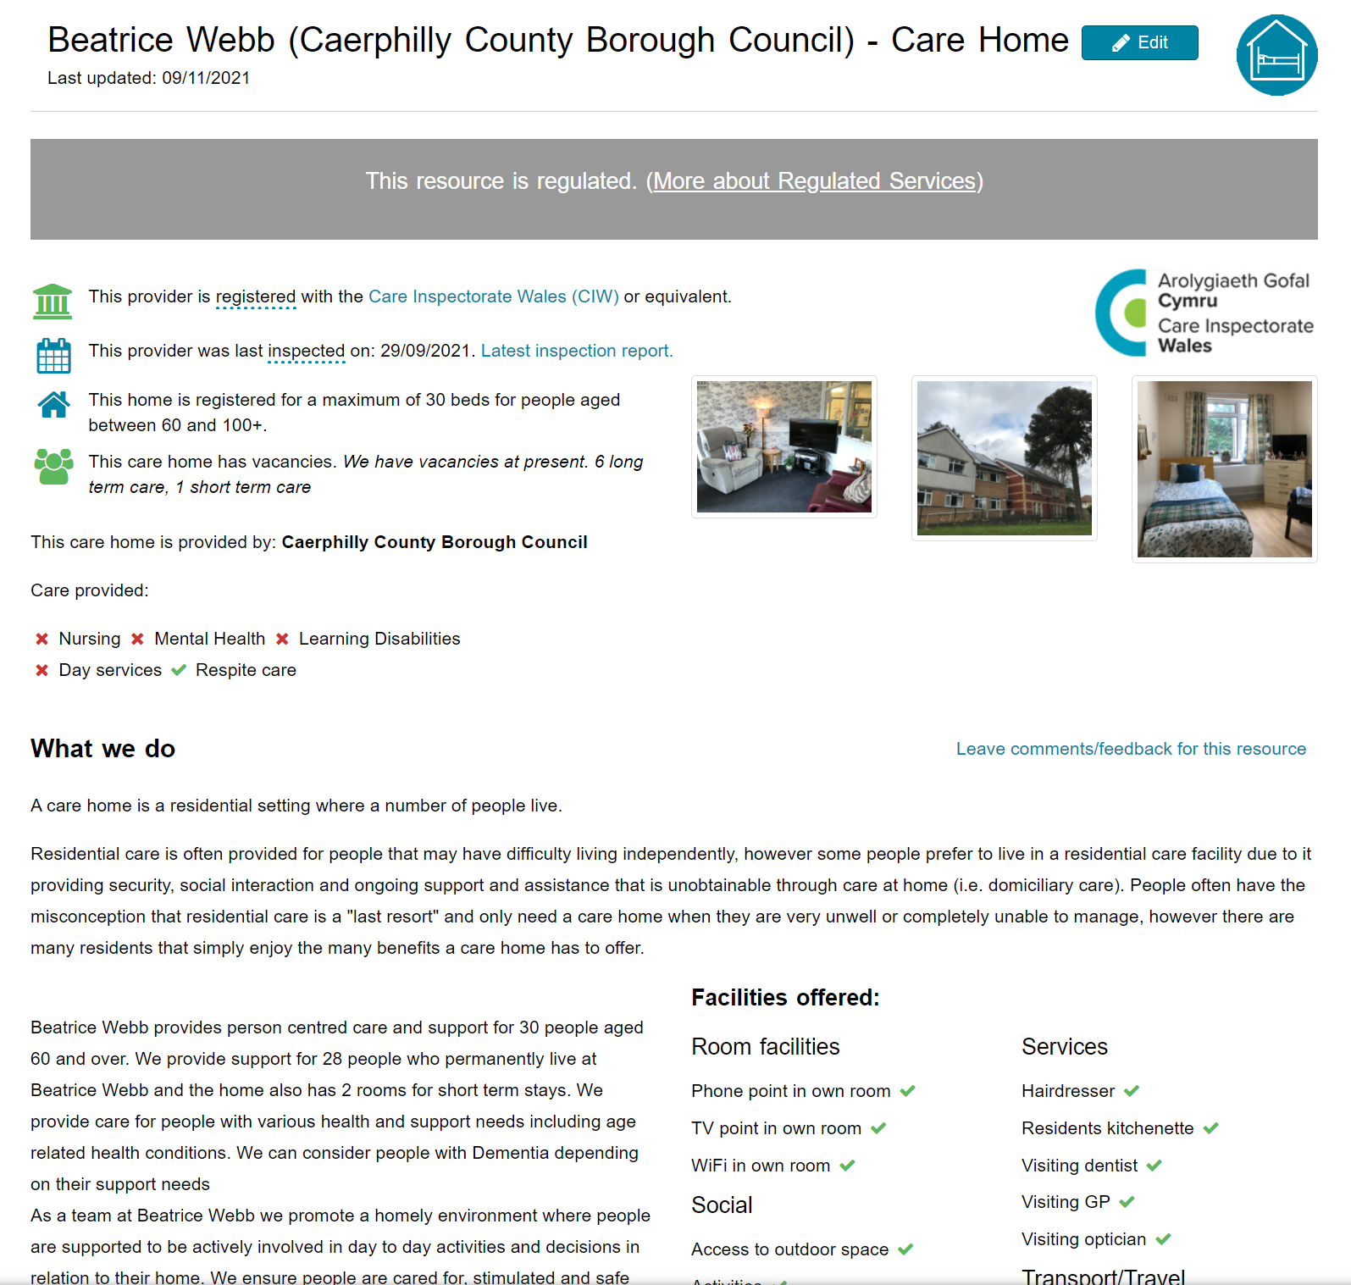
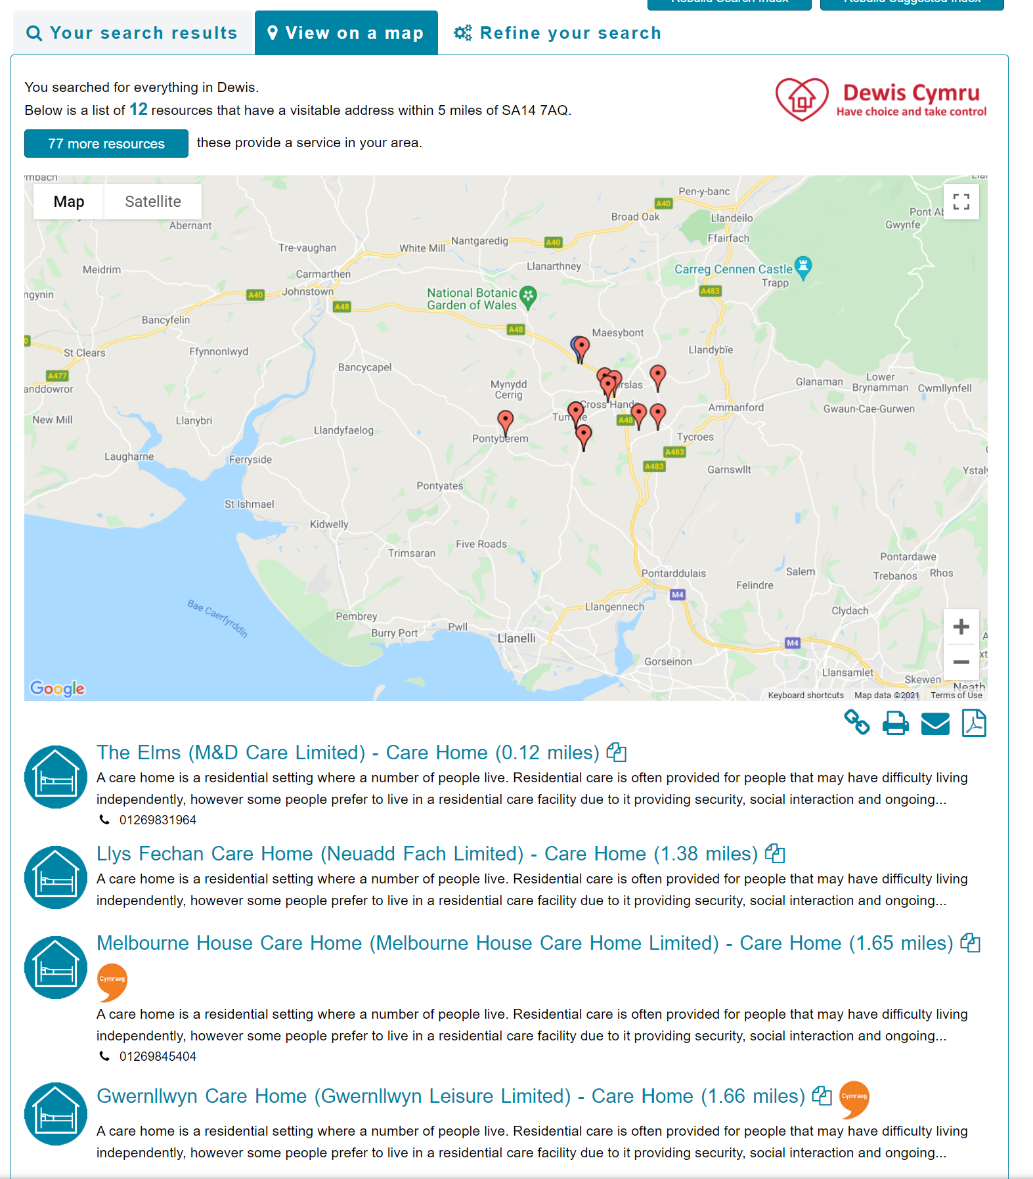
Dewis screen shots…

Slide 36
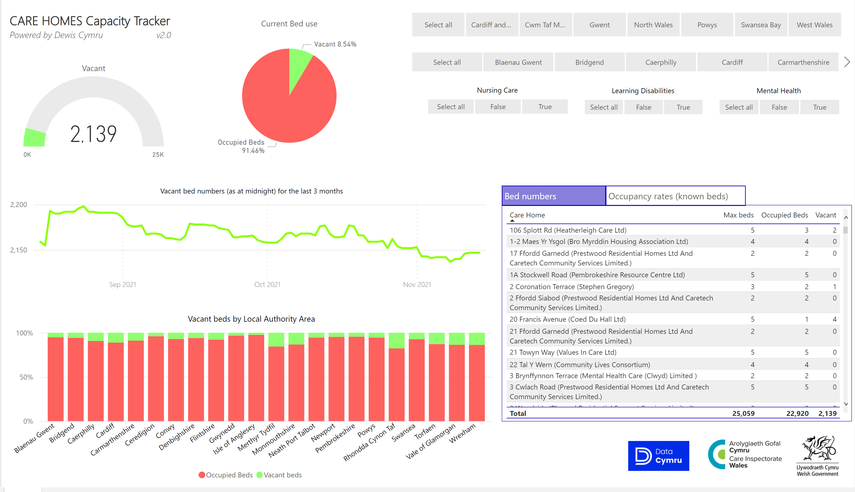
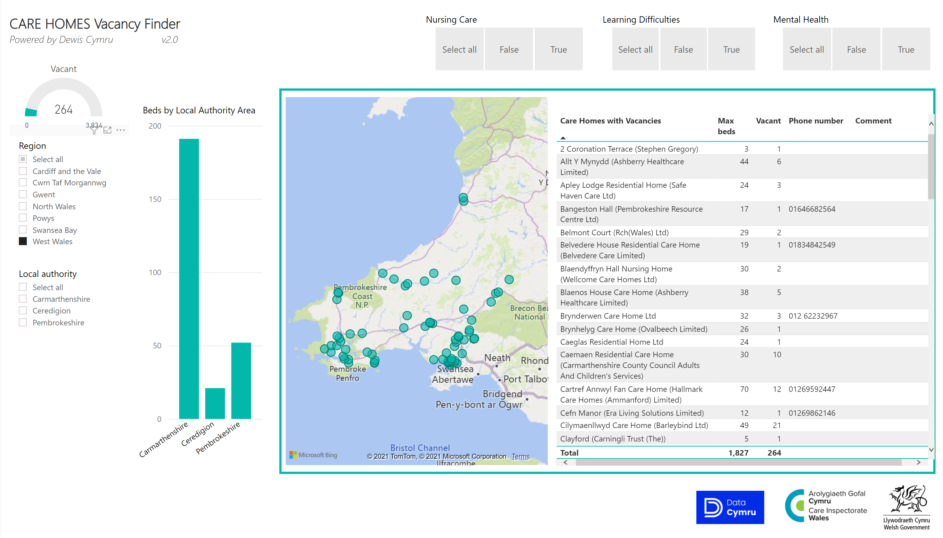
Example dashboards…

Slide 37
Dewis Cymru…
To see your entries on Dewis visit https://www.dewis.wales/ and search for the ‘Care Home’ category…
For support using the system email
Help@dewis.wales

Slide 38
Any questions???
Richard Palmer
Chief Operating Officer, Data Cymru
richard.palmer@data.cymru
029 2090 9502 or 07866 428735

Slide 39
Diolch
Thank you

