Slide 1
DIWEDDARIAD / UPDATE Cofrestru ac Arolygu Gofal Plant a Chwarae Childcare and Play Inspection and Registration

Slide 2
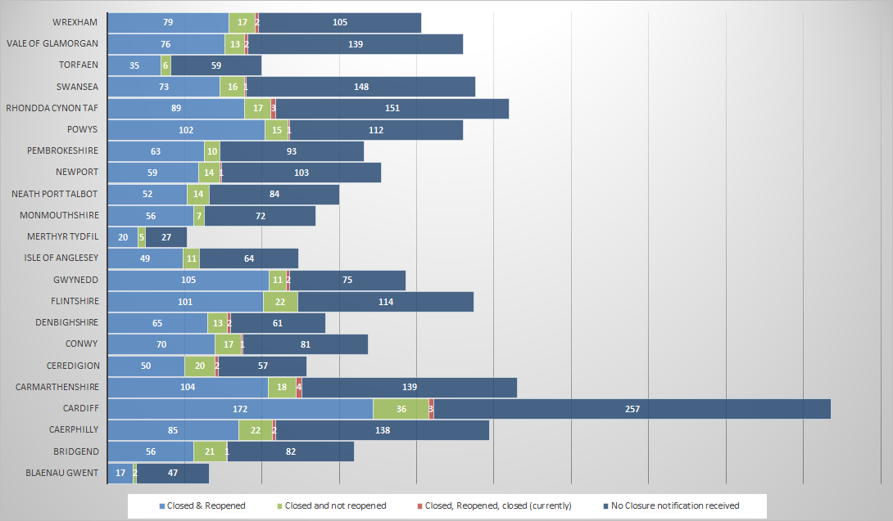
Gwasanaethau gofal plant a chwarae – Achosion o gau gwasanaethau dros dro o ganlyniad i COVID-19 a’u hailagor, yn gywir ar 13/11/2020
Galwadau dal i fyny/monitro
Cyfanswm y galwadau dal i fyny â gwasanaethau gofal plant a chwarae yn ystod COVID-19 yw 2,840 (caeodd yr arolwg ar 08/10/20).
Ar 12/11/20, cyfanswm cyfredol y galwadau monitro yw 537.
Childcare and play services – Temporary closures due to COVID-19 and re-openings as at 13/11/2020
Check-in/monitoring calls:
COVID-19 childcare and play check-in calls total is 2,840 calls (survey closed on 08/10/2020).
As at 12/11/2020 the total number of monitoring calls currently stands at 537.

Slide 3
Diweddariad ar y broses gofrestru AGC / CIW Registration update

Slide 4
AGC Ar-lein / CIW Online
Yn fyw ym mis Chwefror 2020
Dull syml o fynd i’r afael â’n gwaith
Cofrestriadau – 120
Amrywiadau – 205
Archwilio’r gofrestr
Live in February 2020
Streamlined approach to our work
Registrations – 120
Variations – 205
Audit of the register

Slide 5
Ymateb i’r pandemig Response to the pandemic
Blaenoriaethu ein gwaith
Addasu ein dull gweithredu
Y sefyllfa ddiweddaraf
Prioritisation of work
Adapted approach
Where are we now?

Slide 6
Datganiad Hunanasesu Gwasanaeth (SASS) 2020 – y prif ganfyddiadau / SASS 2020 – findings

Slide 7
Datganiad Hunanasesu Gwasanaeth / Self-Assessment of Service Statement (SASS) 2020
3,113 submitted the SASS (88%)
Childminders (46%), Full Day Care (28.3%) and Sessional Care (14.7%)
South East 39.3%, South West 33.7%, North 27%
521 – early years education
14% Welsh medium
17% provide the ‘active offer’
Cyflwynwyd 3,113 o Ddatganiadau Hunanasesu Gwasanaeth (88%)
Gwarchodwyr Plant (46%), Gofal Dydd Llawn (28.3%) a Gofal Sesiynol (14.7%)
De-ddwyrain 39.3%, De-orllewin 33.7%, Gogledd 27%
521 – addysg y blynyddoedd cynnar
14% – cyfrwng Cymraeg
17% yn darparu’r ‘cynnig rhagweithiol’

Slide 8
Datganiad Hunanasesu Gwasanaeth / Self-Assessment of Service Statement (SASS) 2020
Gwelwyd bod 22.3% (3,402) o’r staff mewn gwasanaethau blynyddoedd cynnar a gofal plant yn gweithio llai nag 16 awr yr wythnos
Dywed y mwyafrif o’r gwarchodwyr plant fod ganddynt gymhwyster lefel 3.
Mae’r rhan fwyaf o’r ymarferwyr gofal plant a chwarae yn bodloni’r gofynion o ran cymwysterau a nodir yn y Safonau Gofynnol Cenedlaethol.
22.3% (3,402) of staff in all early years and childcare service were found to be working less than 16 hours per week
Majority of child minders state that they have a level 3 qualification.
Most childcare and play practitioners are meeting the qualification requirements set out in the NMS.

Slide 9
Diweddariad gan polisi gofal plant a chwarae / Update from childcare and play policy

Slide 10
Diweddariad ar Ofal Plant, Chwarae a’r Blynyddoedd Cynnar
Childcare, Play and Early Years Update

Slide 11
Heriau/Challenges
Covid-19
Galw/ Demand
Agwedd rhieni/ Parental attitudes
Addasu i newidiadau cyflym/ Adapting to rapid changes
Mynediad i safleoedd/Access to premises
Materion yn ymwneud â’r gweithlu/ Workforce issues
Hyfywedd ariannol/ Financial viability

Slide 12
Y cymorth a ddarparwyd/Support provided
Grantiau a chyllid/Grants and funding
Canllawiau a chwestiynau cyffredin/Guidance & FAQs
Llacio’r Safonau Gofynnol Cenedlaethol/
Relaxing the National Minimum Standards (NMS)
CCAS a’r Cynnig Gofal Plant/CCAS and the Childcare Offer
Ymgyrch i roi sicrwydd i rhieni/Parental reassurance campaign

Slide 13
Monitro a’n cynigion ar gyfer cymorth parhaus Monitoring and our proposals for ongoing support
Hyfforddiant / Training
Cymorth busnes/ Business support
Monitro ac ymchwil/ Monitoring & research
Prosiect Digidol / Digital Project
Notes:
1. Monitoring & research –
We are incredibly grateful to you [providers] and to CIW for the information you provide which help us to understand changes in the sector. We routinely analyse registration data and notifications, and often link this to the detailed information you provided us in your SASS. This has provided evidence to inform policy, delivery and legislative decisions. For example, seeing the high number of temporary notifications due to Covid at the start of the outbreak supported the case for C-CAS and the provider grant. Another example is the responses from 749 settings to our survey in May which informed standards and guidance on Coronavirus protective measures. So thank you for the support you give us by telling us about your setting and views.
Ongoing support –
2. Business Support: The deadlines for our Business Wales Grants for childminder start ups and wage subsidy (new entrants) have been extended and so those that have already applied have longer to draw down the funding. We have developed a business support resource to sign post sources of a variety of advice relating to the running of a setting, we are hoping to make this available in early 2021.
3. Training – Qualification and apprenticeships continue to be provided with adaptations being made to the delivery of learning and support for participants. Progress for Success funding is available to those seeking to access Level 3 qualifications. We are currently procuring learning providers to deliver for the Level 3 Transition to Play Award which will be available in 2021.
4. Digital Project - WG are working with contractor Kainos to develop a new, national digital service to deliver the Childcare Offer across Wales
We want to engage with as many providers as possible in developing the service
We’ll be holding workshops on transition issues and user labs to test the prototypes to ensure the resulting service meets needs and expectations
To get involved (and to get a sneak preview of how the service will work), contact: Digital.Childcare@gov.wales
A Get Prepared comms campaign will kick off in the coming months to ensure all stakeholders know what they need to do and when in order to use the service

Slide 14
Clywed gennych…
Hearing from you…
Cysylltwch / Get in touch
trafodgofalplant@llyw.cymru
talkchildcare@gov.wales
Prosiect Digidol/Digital Project
gofalplant.digidol@llyw.cymru
digital.childcare@gov.wales

