Slide 1
Balancing Rights, Risks and Responsibilities Cydbwyso Hawliau, Risgiau a Chyfrifoldebau
Imogen Blood
Care Inspectorate Wales / Social Care Wales Learning Event
16th December 2020
Digwyddiad Dysgu Arolygiaeth Gofal Cymru / Gofal Cymdeithasol Cymru
16 Rhagfyr 2020

Slide 2
Introduction
Cyflwyniad
3 projects on this topic by Imogen Blood & Associates / Practice Solutions for Social Care Wales:
Positive risk and shared decision making (2018/19)
Co-produced practice principles (2019/20)
Balancing Risks, Rights and Responsibilities in Child Protection Services (2019)
Tri phrosiect ar y pwnc hwn gan Imogen Blood & Associates / Practice Solutions ar gyfer Gofal Cymdeithasol Cymru
Risgiau cadarnhaol a phenderfyniadau a rennir (2018/19)
Egwyddorion ymarfer a gyd-gynhyrchir (2019/20)
Cydbwyso Risgiau, Hawliau a Chyfrifoldebau mewn Gwasanaethau Amddiffyn Plant (2019)

Slide 3
What does it mean to ‘balance risks, rights and responsibilities’?
Beth mae ‘cydbwyso risgiau, hawliau a chyfrifoldebau’ yn ei olygu?
Start with what matters most to the person
Time, skills and listening; trust and respect
Don’t make assumptions: remain curious
Weigh up the risks of different options – of doing nothing as well as doing something, of putting in a service as well as not, etc.
Dechrau gyda'r hyn sy'n bwysicaf i'r unigolyn
Amser, sgiliau a gwrando; ymddiriedaeth a pharch
Peidio â gwneud rhagdybiaethau: cynnal chwilfrydedd
Pwyso a mesur risgiau opsiynau gwahanol – gwneud dim byd yn ogystal â gwneud rhywbeth, rhoi gwasanaeth ar waith yn ogystal â pheidio â gwneud hynny, ac ati

Slide 4
What does it mean to ‘balance risks, rights and responsibilities’? (cont.)
Beth mae ‘cydbwyso risgiau, hawliau a chyfrifoldebau’ yn ei olygu? (parh.)
Hear everyone’s hopes and fears
Don’t overlook risk of emotional/ psychological harm
Work together to use available resources creatively while reducing risks
Things can change: keep plans flexible; review risk assessments regularly
Clywed gobeithion ac ofnau pawb
Peidio â diystyru risgiau o niwed emosiynol / seicolegol
Cydweithio i ddefnyddio'r adnoddau sydd ar gael yn greadigol gan leihau risgiau ar yr un pryd
Gall pethau newid: cadw cynlluniau'n hyblyg; adolygu asesiadau risg yn rheolaidd

Slide 5
Why work in this way? Better outcomes
Pam gweithio yn y ffordd hon? Canlyniadau gwell
Collaboration in decision-making and planning
Working towards the outcomes that matter, whilst maximising safety
More cost effective
Cydweithredu wrth wneud penderfyniadau a chynllunio
Gweithio tuag at ganlyniadau sy'n bwysig, gan sicrhau'r diogelwch eithaf
Mwy costeffeithiol

Slide 6
Why work in this way? Law, policy & regulation
Pam gweithio yn y ffordd hon? Deddfau, polisïau a rheoliadau
Social Services and Wellbeing Act
The Code of Practice for Inspection
Codes of Professional Practice
Mental Capacity Act 2005
Human Rights Act 1998
Equality Act 2010
Y Ddeddf Gwasanaethau Cymdeithasol a Llesiant
Y Cod Ymarfer ar gyfer Arolygu
Codau Ymarfer Proffesiynol
Deddf Galluedd Meddyliol 2005
Deddf Hawliau Dynol 1998
Deddf Cydraddoldeb 2010

Slide 7
Whose risk is it anyway? Hopes and fears
Risg i bwy? Gobeithion ac ofnau
Losing my independence
Not having control over my life
Being isolated
Not being able to do the things that matter to me
Losing my confidence
Not being heard
Colli fy annibyniaeth
Diffyg rheolaeth dros fy mywyd
Bod yn ynysig
Methu gwneud y pethau sy'n bwysig i mi
Colli fy hyder
Peidio â chael fy nghlywed

Slide 8
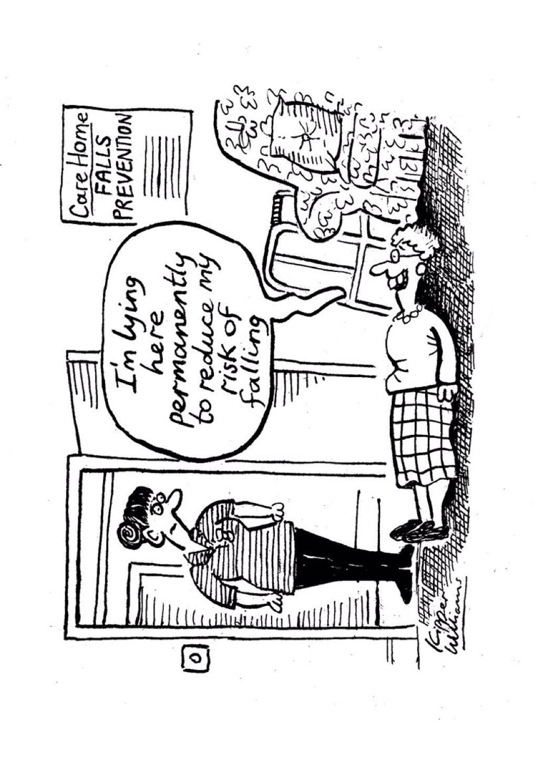
Tendency to prioritise physical safety
Tueddiad i flaenoriaethu diogelwch corfforol
Cartref Gofal
Atal Cwympiadau
“Rwy’n gorwedd yma’n barhaus er mwyn lleihau fy risg o gwympo”

Slide 9
What can get in the way?
Beth all fod yn rhwystr?
Fear of law/ regulation – ‘duty of care’
Lack of understanding from other colleagues, relatives
Lack of time/ responding to crises
Performance judged by outputs
Feeling defensive, unsupported
Ofn deddfau / rheoliadau – ‘dyletswydd i ofalu’
Diffyg dealltwriaeth ymhlith cydweithwyr eraill, perthnasau
Diffyg amser / ymateb i argyfyngau
Beirniadu perfformiad ar sail allbynnau
Teimlo'n amddiffynnol, heb gefnogaeth

Slide 10
What enables this way of working?
Beth sy'n galluogi'r ffordd hon o weithio?
Organisational commitment to putting this into practice
Staff time and skills development
Regular reflection in supervision/ team meetings
A ‘parallel process’: learning (not blame) culture
Recording decisions: defensible practice
Collective responsibility: wider partnerships
Ymrwymiad sefydliadol i roi hyn ar waith yn ymarferol
Amser staff a datblygu sgiliau
Myfyrio rheolaidd yn ystod sesiynau goruchwylio / cyfarfodydd tîm
‘Proses gyfochrog’: diwylliant o ddysgu (nid rhoi bai)
Cofnodi penderfyniadau: arfer y gellir ei amddiffyn
Cyd-gyfrifoldeb: partneriaethau ehangach

